Slide 1
W4153 – Cloud Computing Lecture 6: REST(4), OAuth2, Middleware, Composition
© Donald F. Ferguson, 2024

Slide 2

Contents
2 | W4153-F24-6-REST(4)-OAuth2-Middleware-Composition © Donald F. Ferguson, 2024

Slide 3
Contents
Questions?
Discuss Sprint 2

Slide 4
Sprint 2 – Discussion
4 | W4153-F24-6-REST(4)-OAuth2-Middleware-Composition © Donald F. Ferguson, 2024

Slide 5
Sprint 2 – Objectives
For all microservices:
OpenAPI documentation.
Good response codes and error codes.
Links for HATEOS
At least one microservice implementing a complete REST interface and accessing a database. Complete means:
All methods and on all paths work/Have basic functionality for CRUD working.
/api/courses: GET, POST
/api/courses/{call_no}: GET, PUT, DELETE
On collection resources, e.g. /api/courses
Query string with parameters.
Pagination.
201 Created with a link header for a POST. Implement GET on link header for created resource.
Simple web UI that calls some of the services.

Slide 6
Sprint 2 – Objectives
One composite microservice/resource, e.g. /api/student_infos, /api/student_infos/{uni}:
Calls/delegates to atomic services for GET and POST.
202 Accepted and implementing an asynchronous update to a URL.
Implement one method synchronously and one asynchronously using threads, co-routines, …
Basic support for navigation paths, including query parameters, e.g. /student_infos/{uni}/courses, /student_infos/{uni}/teams
Middleware on each resource that implements before and after logging for all methods/paths.
Getting the URLs/dependencies from the environment variables.
Deploy the composite and components and test.
OAuth2, OpenIDC using Google login for composite service.
Overall project structure in GitHub:
Linked repositories.
First pass at a Trello board with a backlog.

Slide 7
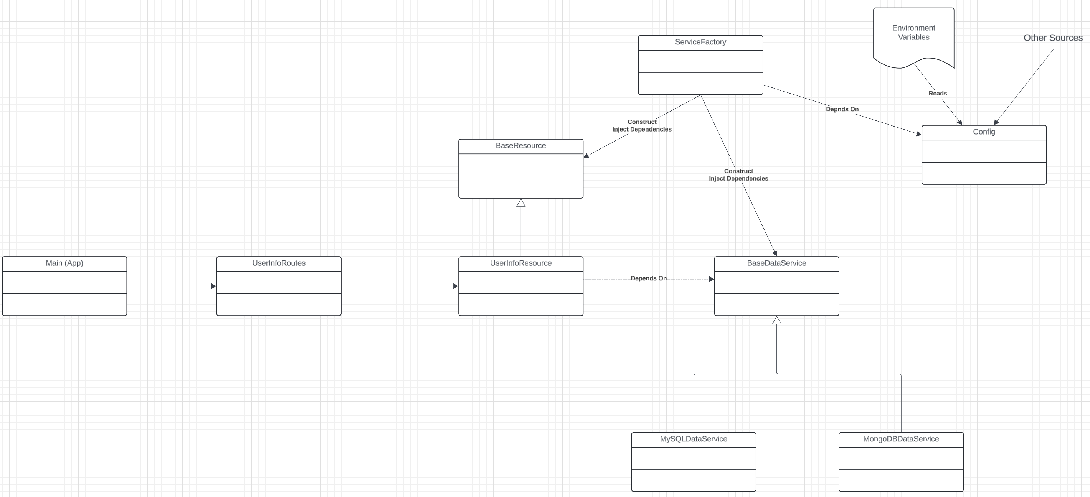
Framework

Slide 8
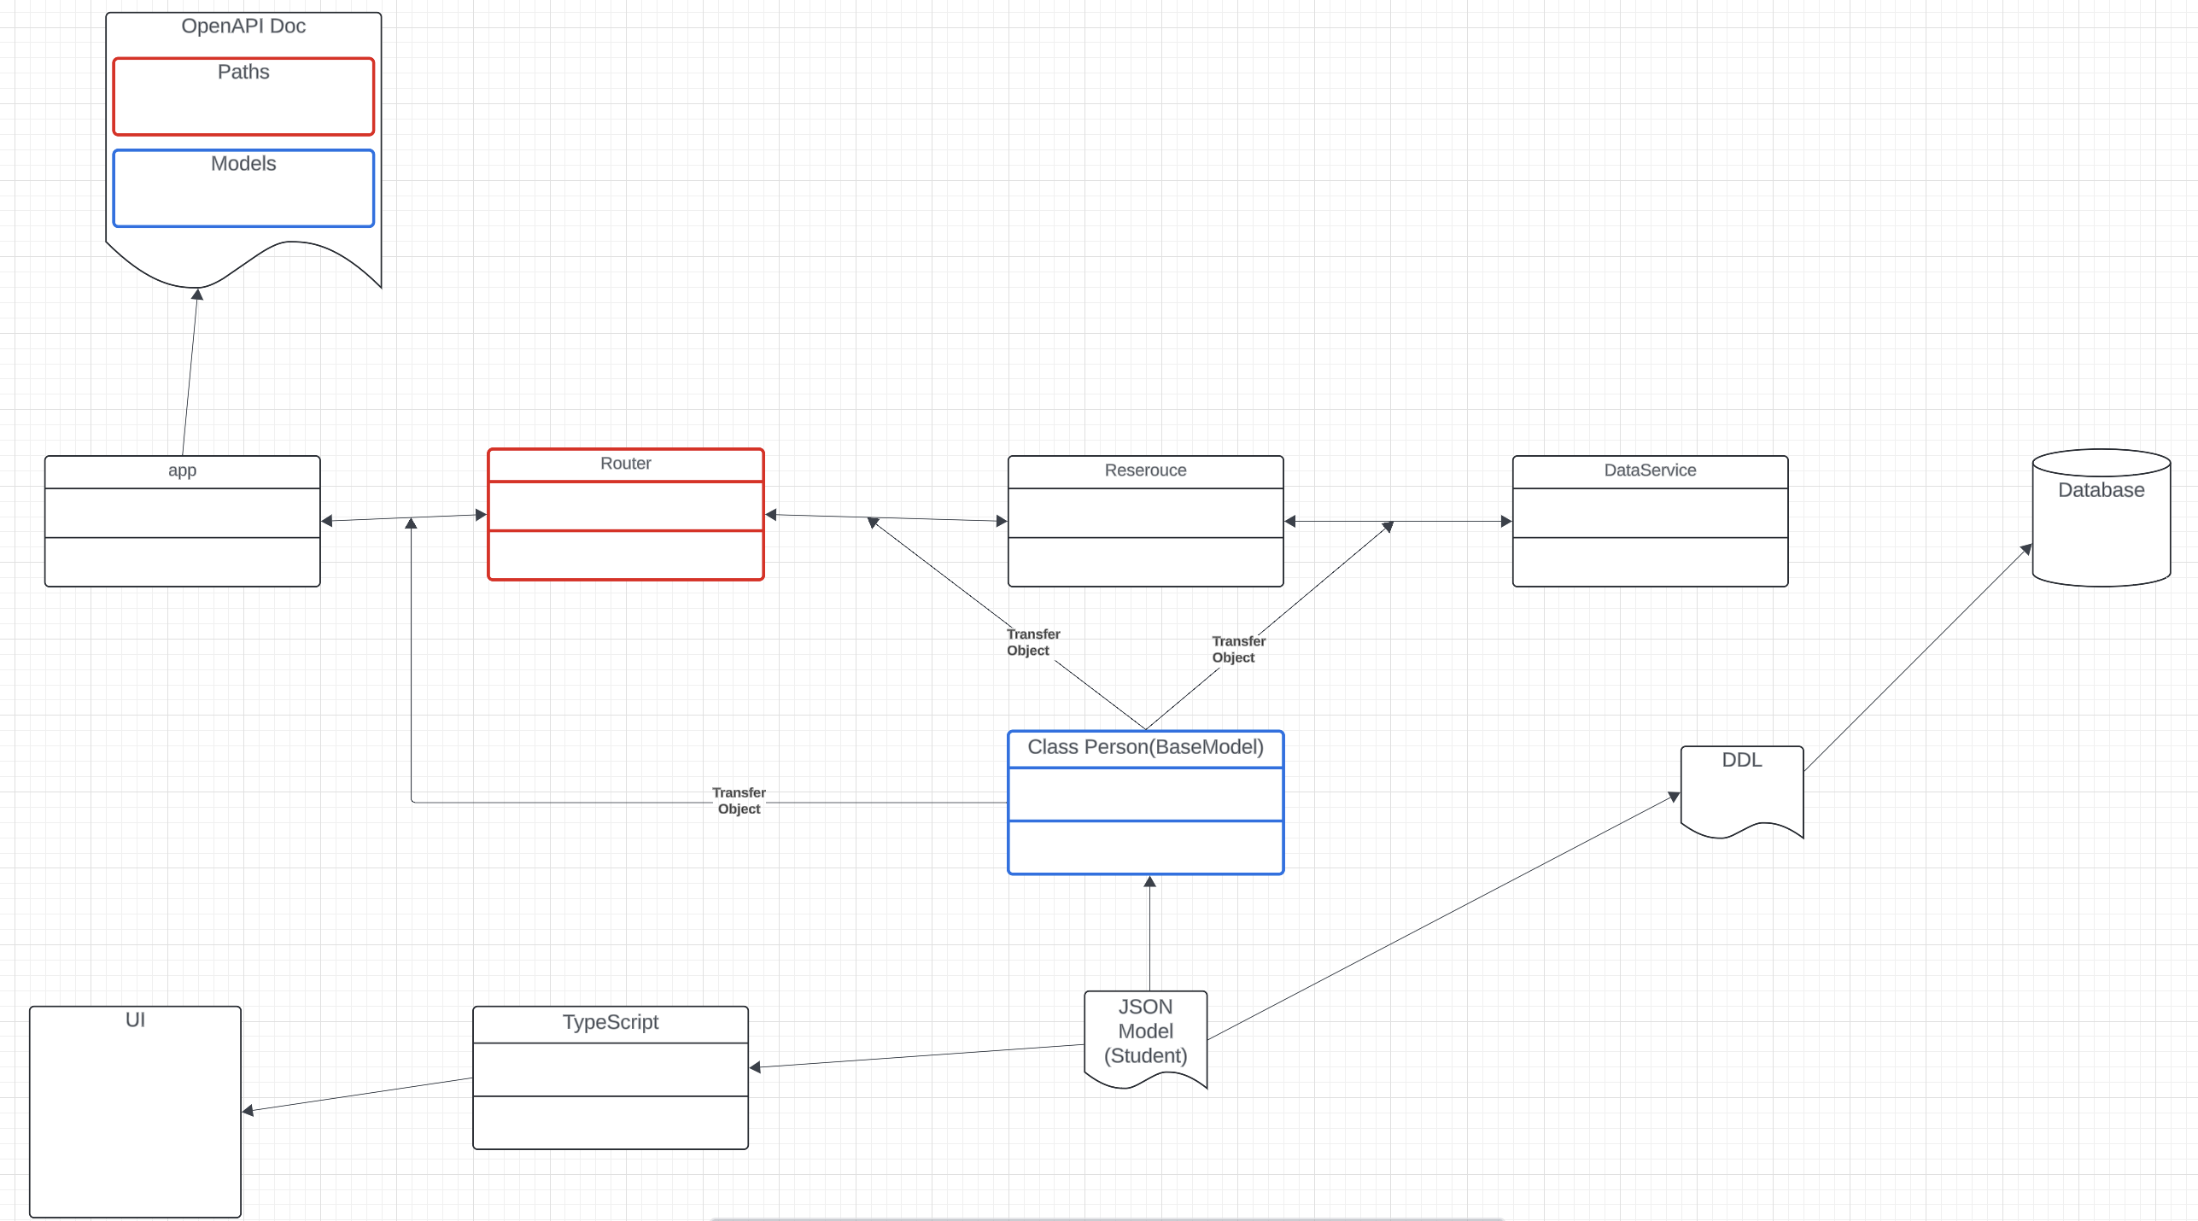
Framework

Slide 9
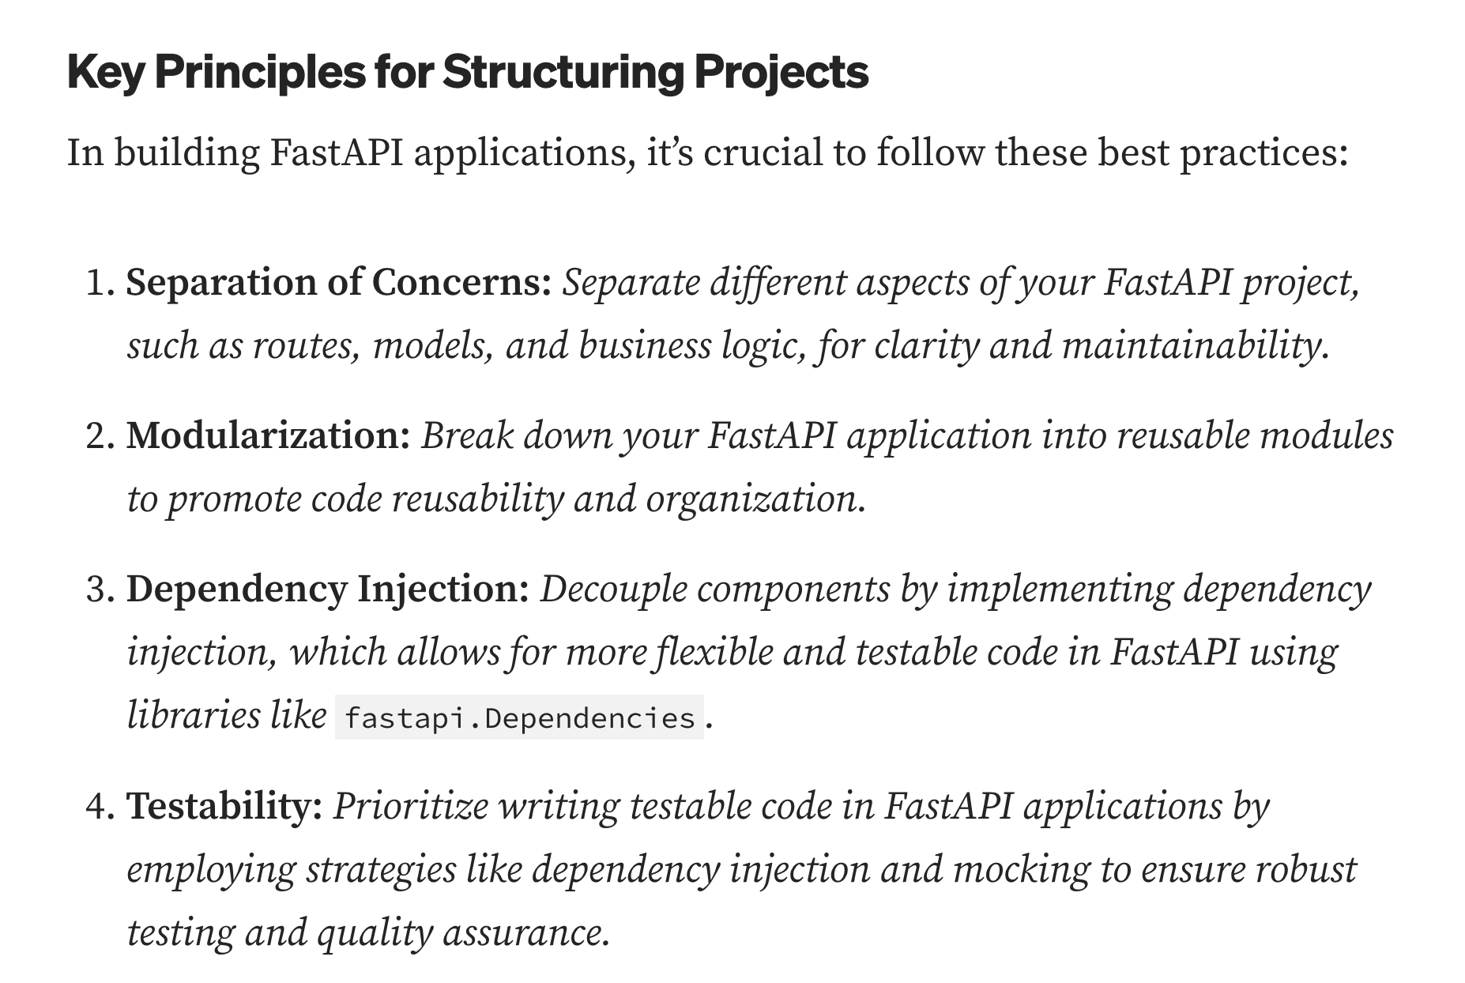
Project Structure
https://medium.com/@amirm.lavasani/how-to-structure-your-fastapi-projects-0219a6600a8f

Slide 10
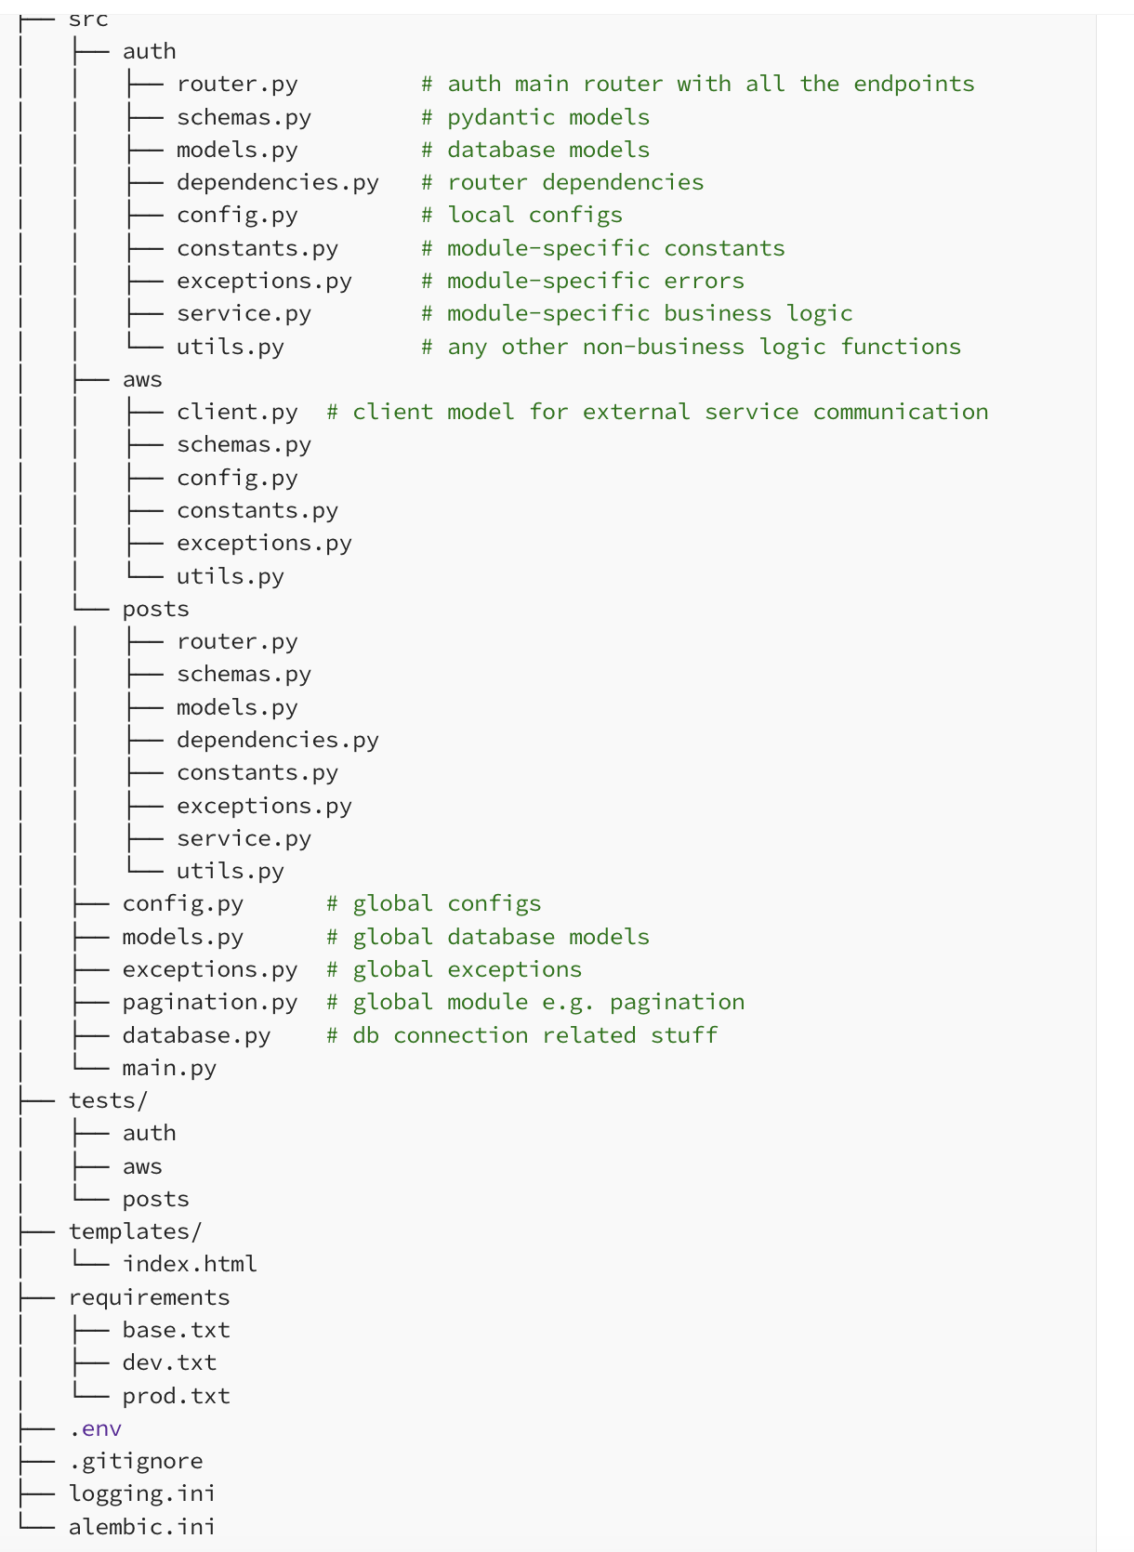
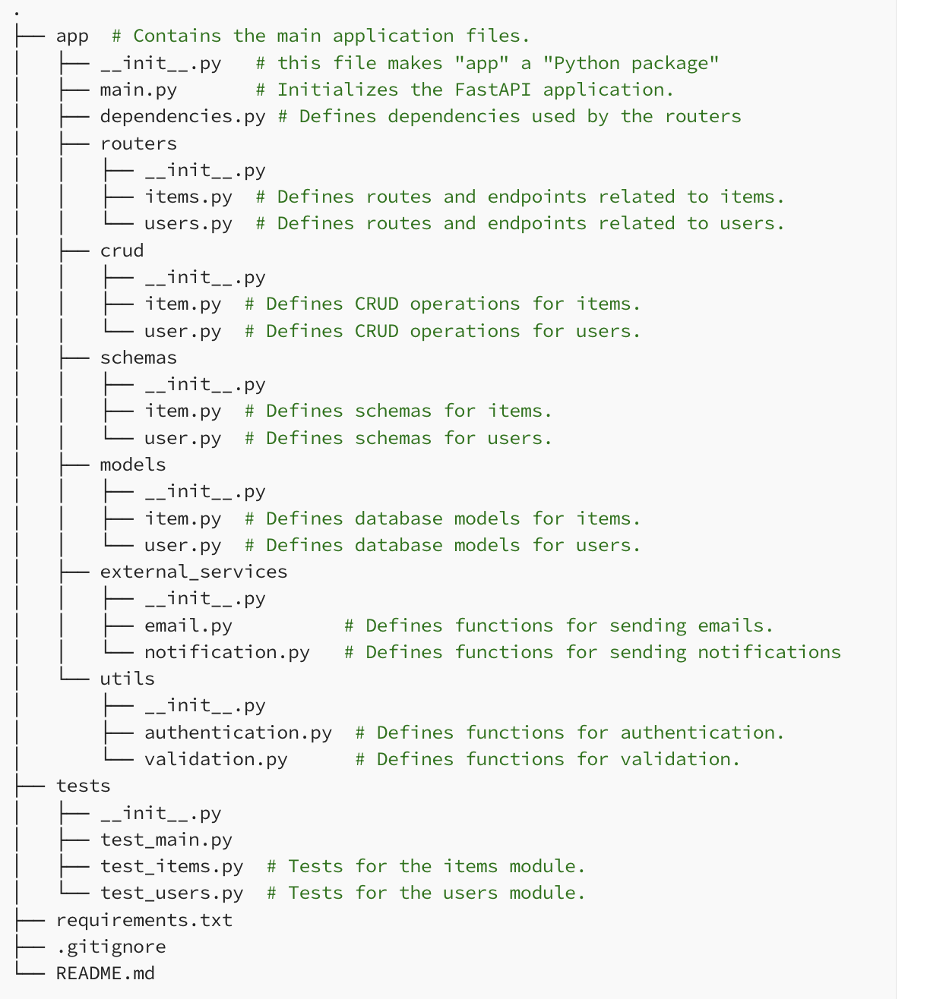
Project Structure
Based on File Type
Module Functionality

Slide 11
Example
https://github.com/zhanymkanov/fastapi-best-practices

Slide 12
OpenID, OAuth2
12 | W4153-F24-6-REST(4)-OAuth2-Middleware-Composition © Donald F. Ferguson, 2024

Slide 13
OAuth2, OpenIDC
Introduction
13 | W4153-F24-6-REST(4)-OAuth2-Middleware-Composition © Donald F. Ferguson, 2024

Slide 14
OpenIDC and Oauth2
OAuth 2.0
OAuth 2.0 is a protocol for authorizing client applications to access protected resources. OAuth 2.0 provides consented access and restricts actions of what the client application can perform on resources on behalf of the user, without ever sharing the user’s credentials.
OpenID Connect
OpenID Connect is an identity layer on top of the OAuth 2.0 protocol. It allows Clients to verify the identity of the End-User based on the authentication performed by an Authorization Server, as well as to obtain basic profile information about the End-User in an interoperable manner.
OpenID exists to enable Federated Authentication, where users are able to authenticate with the same identity across multiple web applications. Both users and web applications trust identity providers, such as Google, Yahoo!, and Facebook, to store user profile information and authenticate users on behalf of the application. This eliminates the need for each web application to build its own custom authentication system, and it makes it much easier and faster for users to sign up and sign into sites around the Web.
https://medium.com/software-development-turkey/understanding-oauth-2-0-and-openid-connect-777eb1fc27f

Slide 15
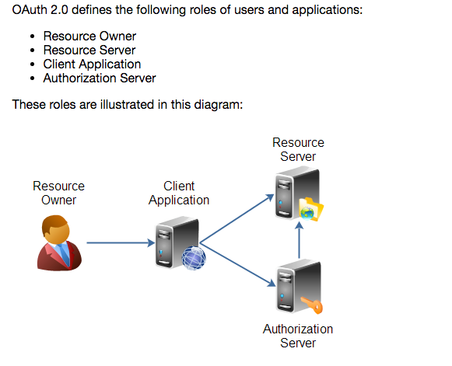
Overview (http://tutorials.jenkov.com/oauth2/index.html)
Resource Owner
Controls access to the “data.”
Facebook user, LinkedIn user, …
Resource Server
The website that holds/manages info.
Facebook, LinkedIn, ...
And provides access API.
Client Application
“The product you implemented.”
Wants to read/update
“On your behalf”
The data the data that the Resource Server maintains, e.g. posts, status, tweets, ...
Authorization Server
Grants/rejects authorization
Based on Resource Owner decisions.
Usually (logically) the same as Resource Server.

Slide 16
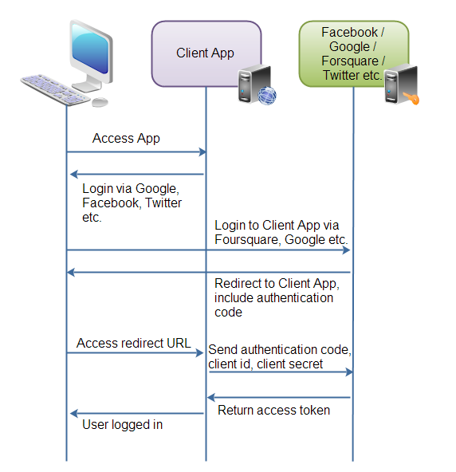
Roles/Flows
User Clicks “Logon with XXX”
Redirect user to XXX
With Client App application ID.
And permissions app requests.
Code MAY have to call Resource Server to get a token to include in redirect URL.
Browser redirected to XXX
Logon on to XXX prompt.
Followed by “do you grant permission to …”
Clicking button drives a redirect back to Client App. URL contains a temporary token.
User/Browser
Redirected to Client App URL with token.
Client App calls XXX API
Obtains access token.
Returns to User.
Client App can use access token on API calls.

Slide 17
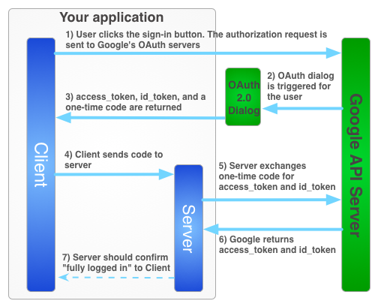
Google

Slide 18
Walkthrough
There are good tutorials: https://medium.com/software-development-turkey/understanding-oauth-2-0-and-openid-connect-777eb1fc27f
Show Coupon App code:
/Users/donald.ferguson/Dropbox/000/00-Current-Repos/student-course-application/course-coupons
dff_framework: File system link but would be pip install.
Environment variables.
Base classes and abstractions
Service factory
Config and basic dependency injection
Google Cloud setup
Consent
URLs

Slide 19
JWT
Introduction
19 | W4153-F24-6-REST(4)-OAuth2-Middleware-Composition © Donald F. Ferguson, 2024

Slide 20
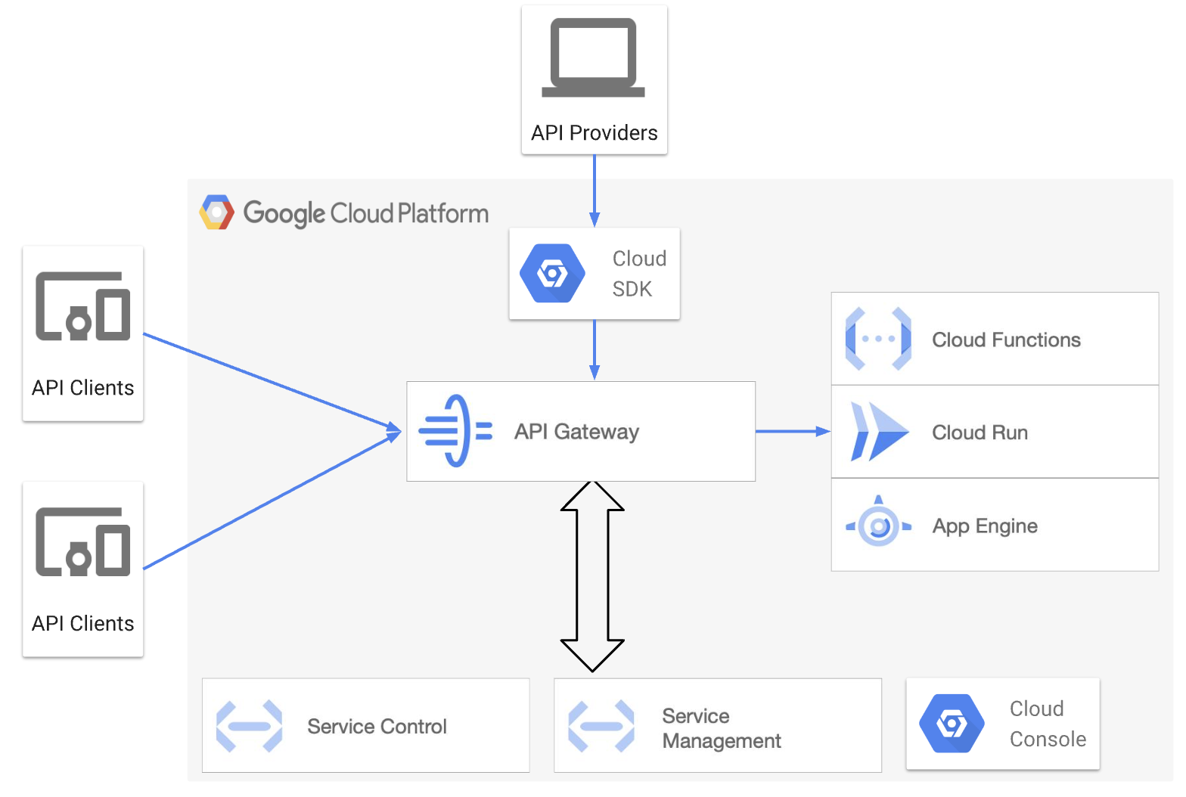
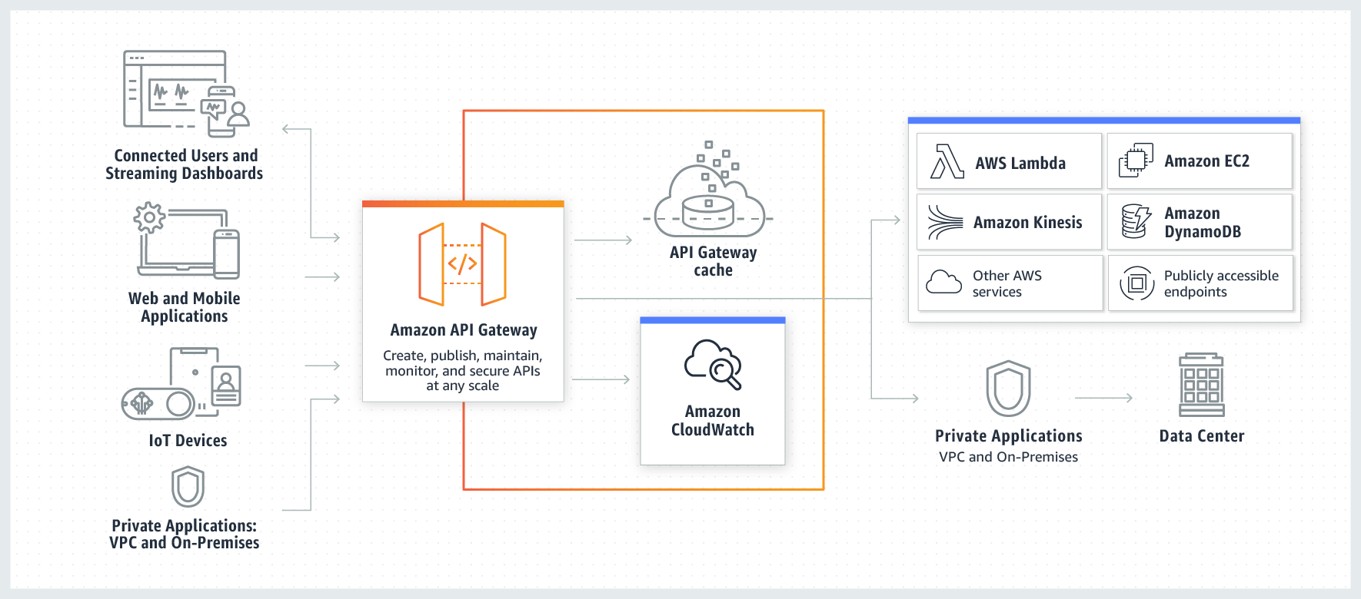
API Gateway
API Management and API Gateways are fundamental concepts.
Vastly simplifies changing microservice architectures, monitoring, enforcing security, throttling, versioning, … …
We will do some simple stuff with a gateway, starting with security.

Slide 21
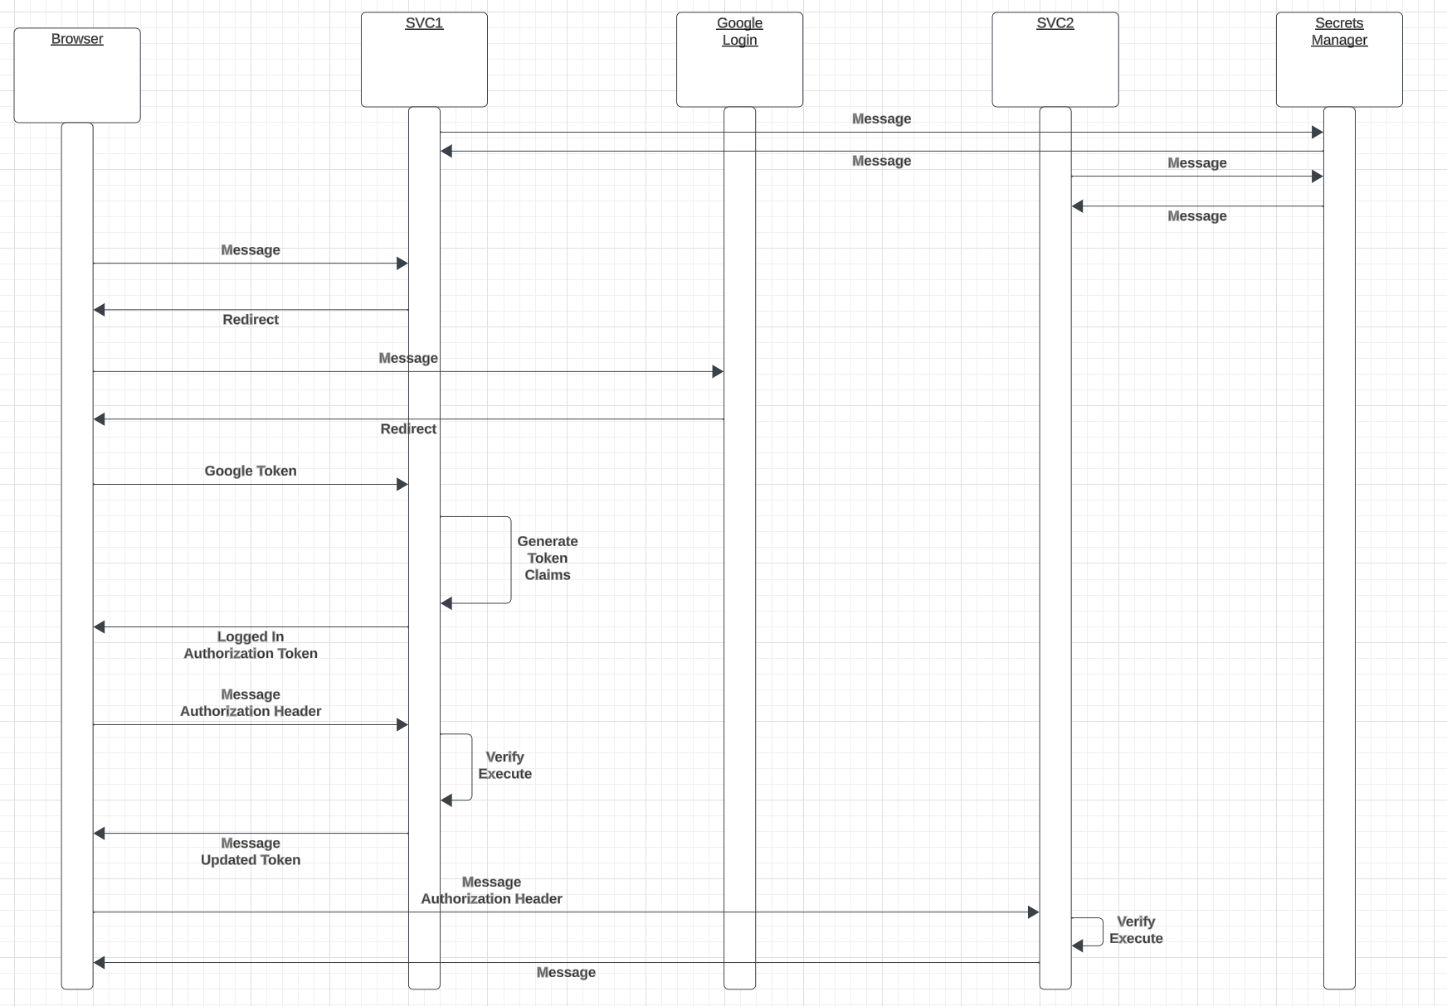
Login and Authorization Tokens
We have seen Google Login.
Forms the basics of authentication.
The server applications:
”Look up” user info in their database and systems.
Determine what operations the user can perform.
Generate a JWT Authorization containing signed claims.
Returns the token in an authorization header.
The client
“Saves” the token.
Attached to subsequent calls.
Servers can then authorize based on
Verifying the signature.
Checking that the client has a claim authorizing the operation.

Slide 22
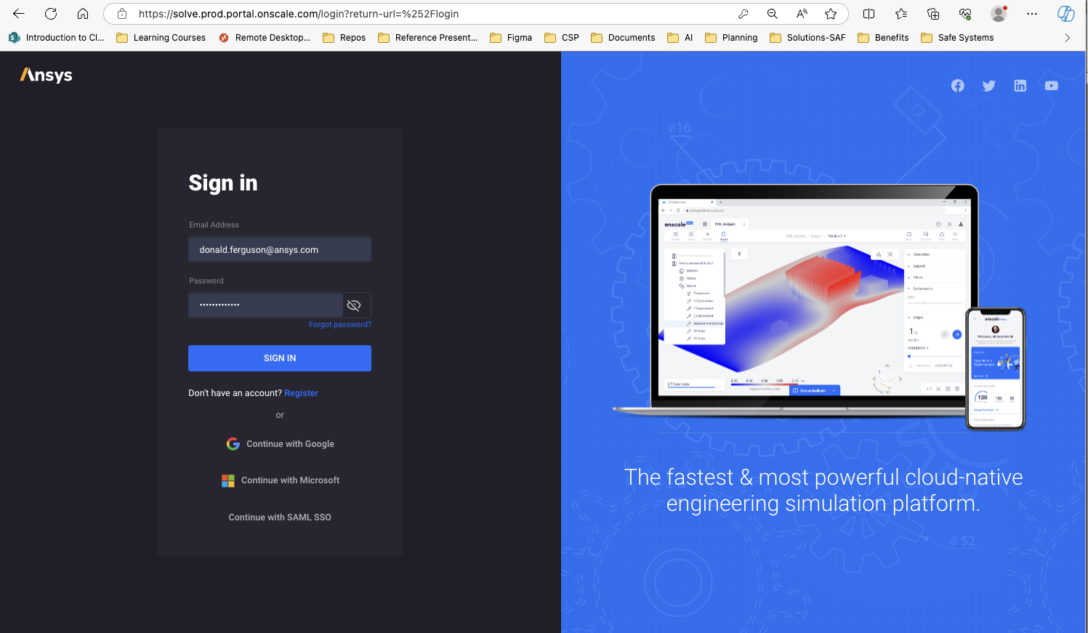
Real Example

Slide 23
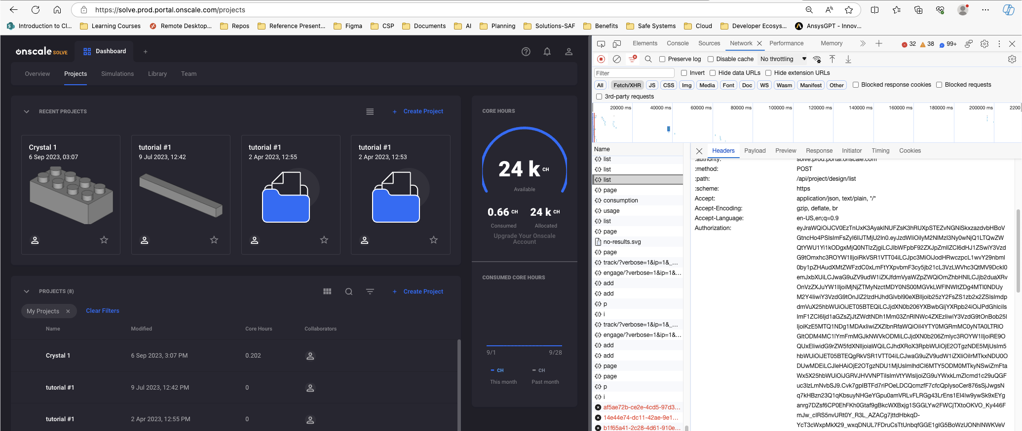
Real Example

Slide 24
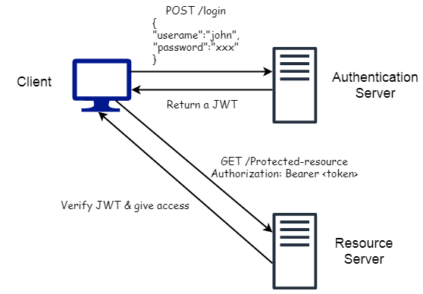
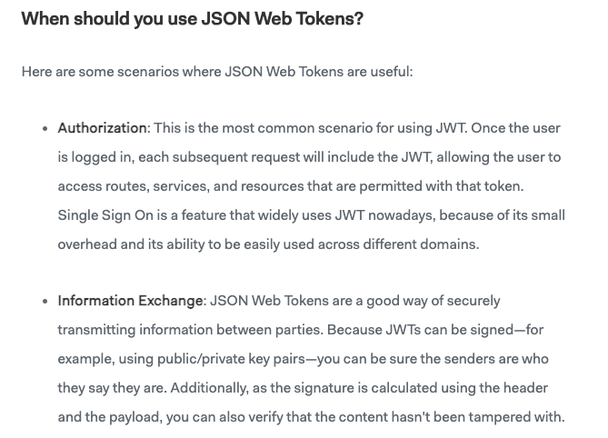
JWT
https://medium.com/swlh/all-you-need-to-know-about-json-web-token-jwt-8a5d6131157f

Slide 25
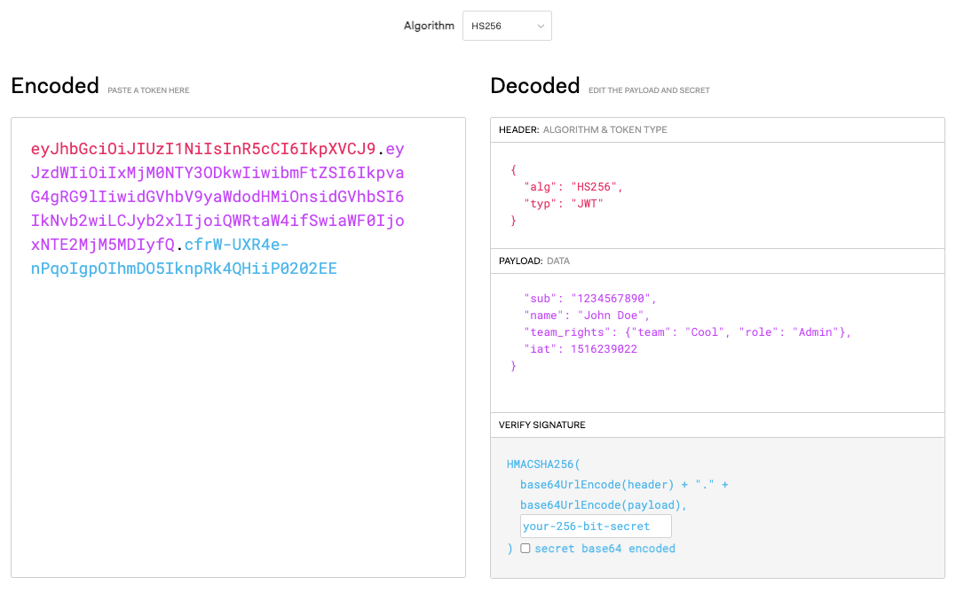
JWT.io

Slide 26
REST Continued
26 | W4153-F24-6-REST(4)-OAuth2-Middleware-Composition © Donald F. Ferguson, 2024

Slide 27
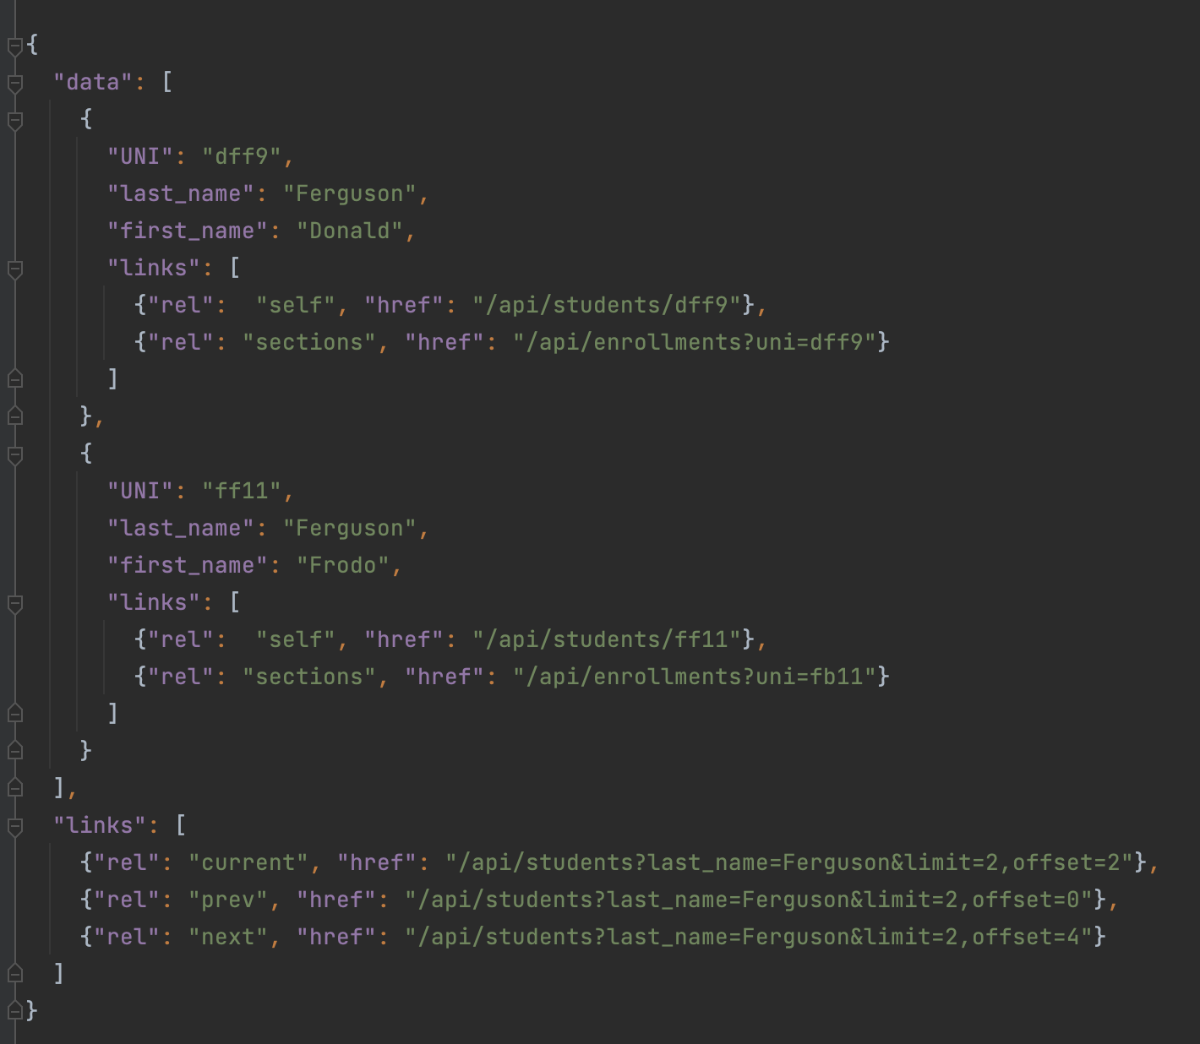
Pagination, Hyper Linked
Bad things may happen when a GET returns a huge result set.
A page is a window on the large result set.
limit is the no. of entries in the result set.
Client may specific a limit.
Server may have a default and/or maximum limit it allows.
There are many design patterns for implementing pagination.
Simplest is mirroring the SQL model:
limit=xxx&offset=yyy
The links section is the response should contain:
prev
next
current
May contain first and last.

Slide 28
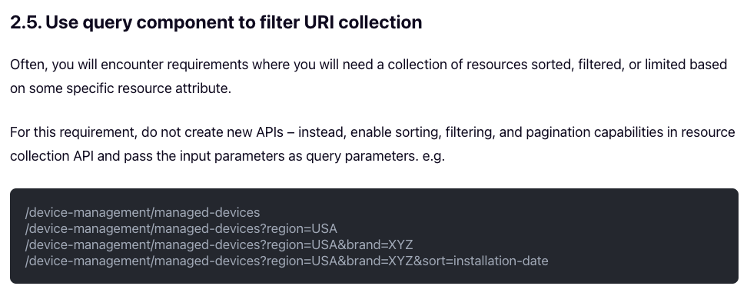
Query Parameters
The basics of query string is very common, e.g. ?region=USA&brand=XYZ
Sort/Order by is not “standard” and APIs pick and document a convention.
Project (choosing a subset of properties) is also not standard. APIs picks and document a convention.

Slide 29
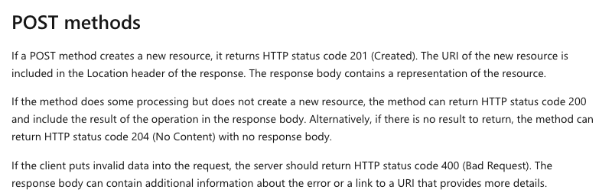
POST -- Creating a Resource
POST sends a body to “create a new resource.”
The identity/URL of the new resource is not always obvious.
POST returns 201 Created with a link header containing the URL to the newly created resource instance.

Slide 30
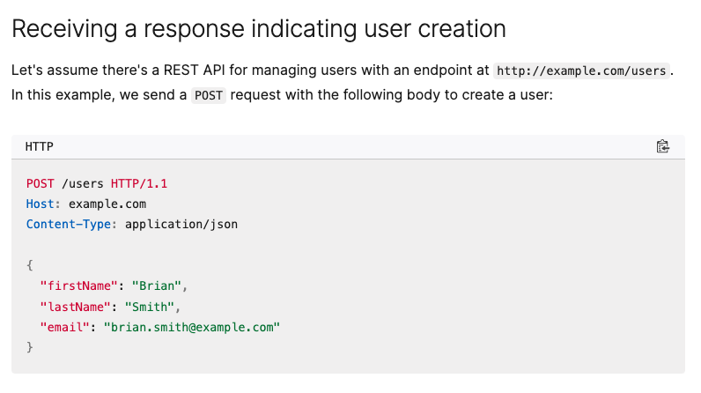
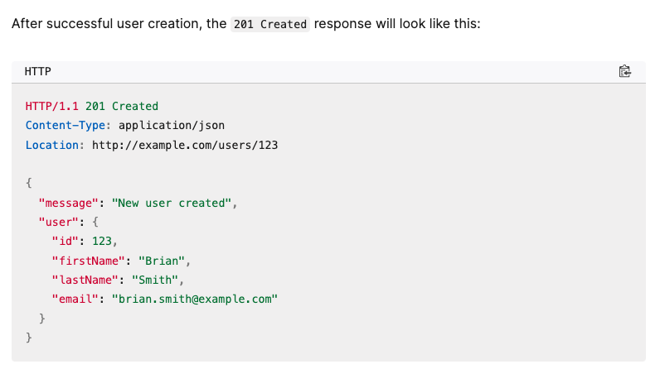
POST

Slide 31
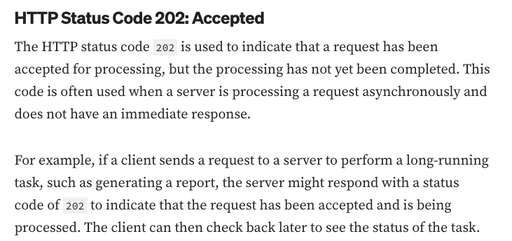
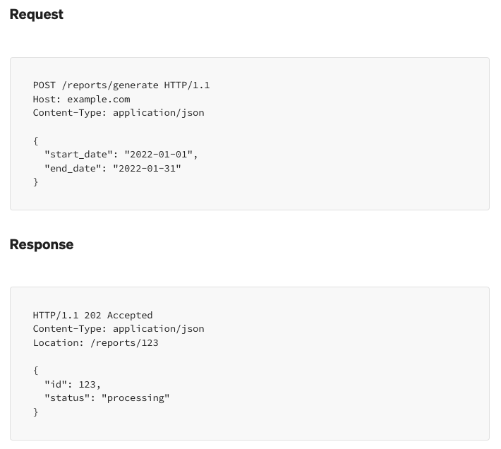
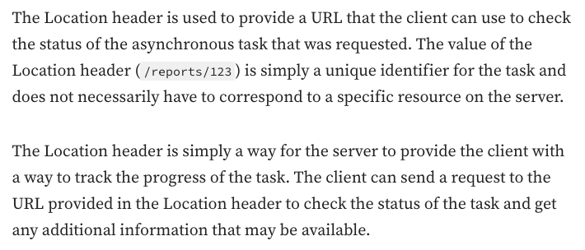
202 Accepted

Slide 32
Composition
32 | W4153-F24-6-REST(4)-OAuth2-Middleware-Composition © Donald F. Ferguson, 2024

Slide 33
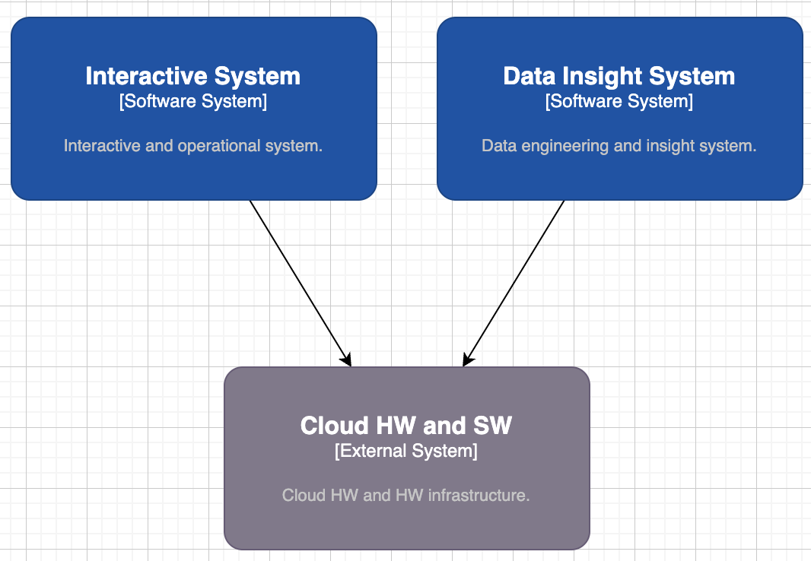
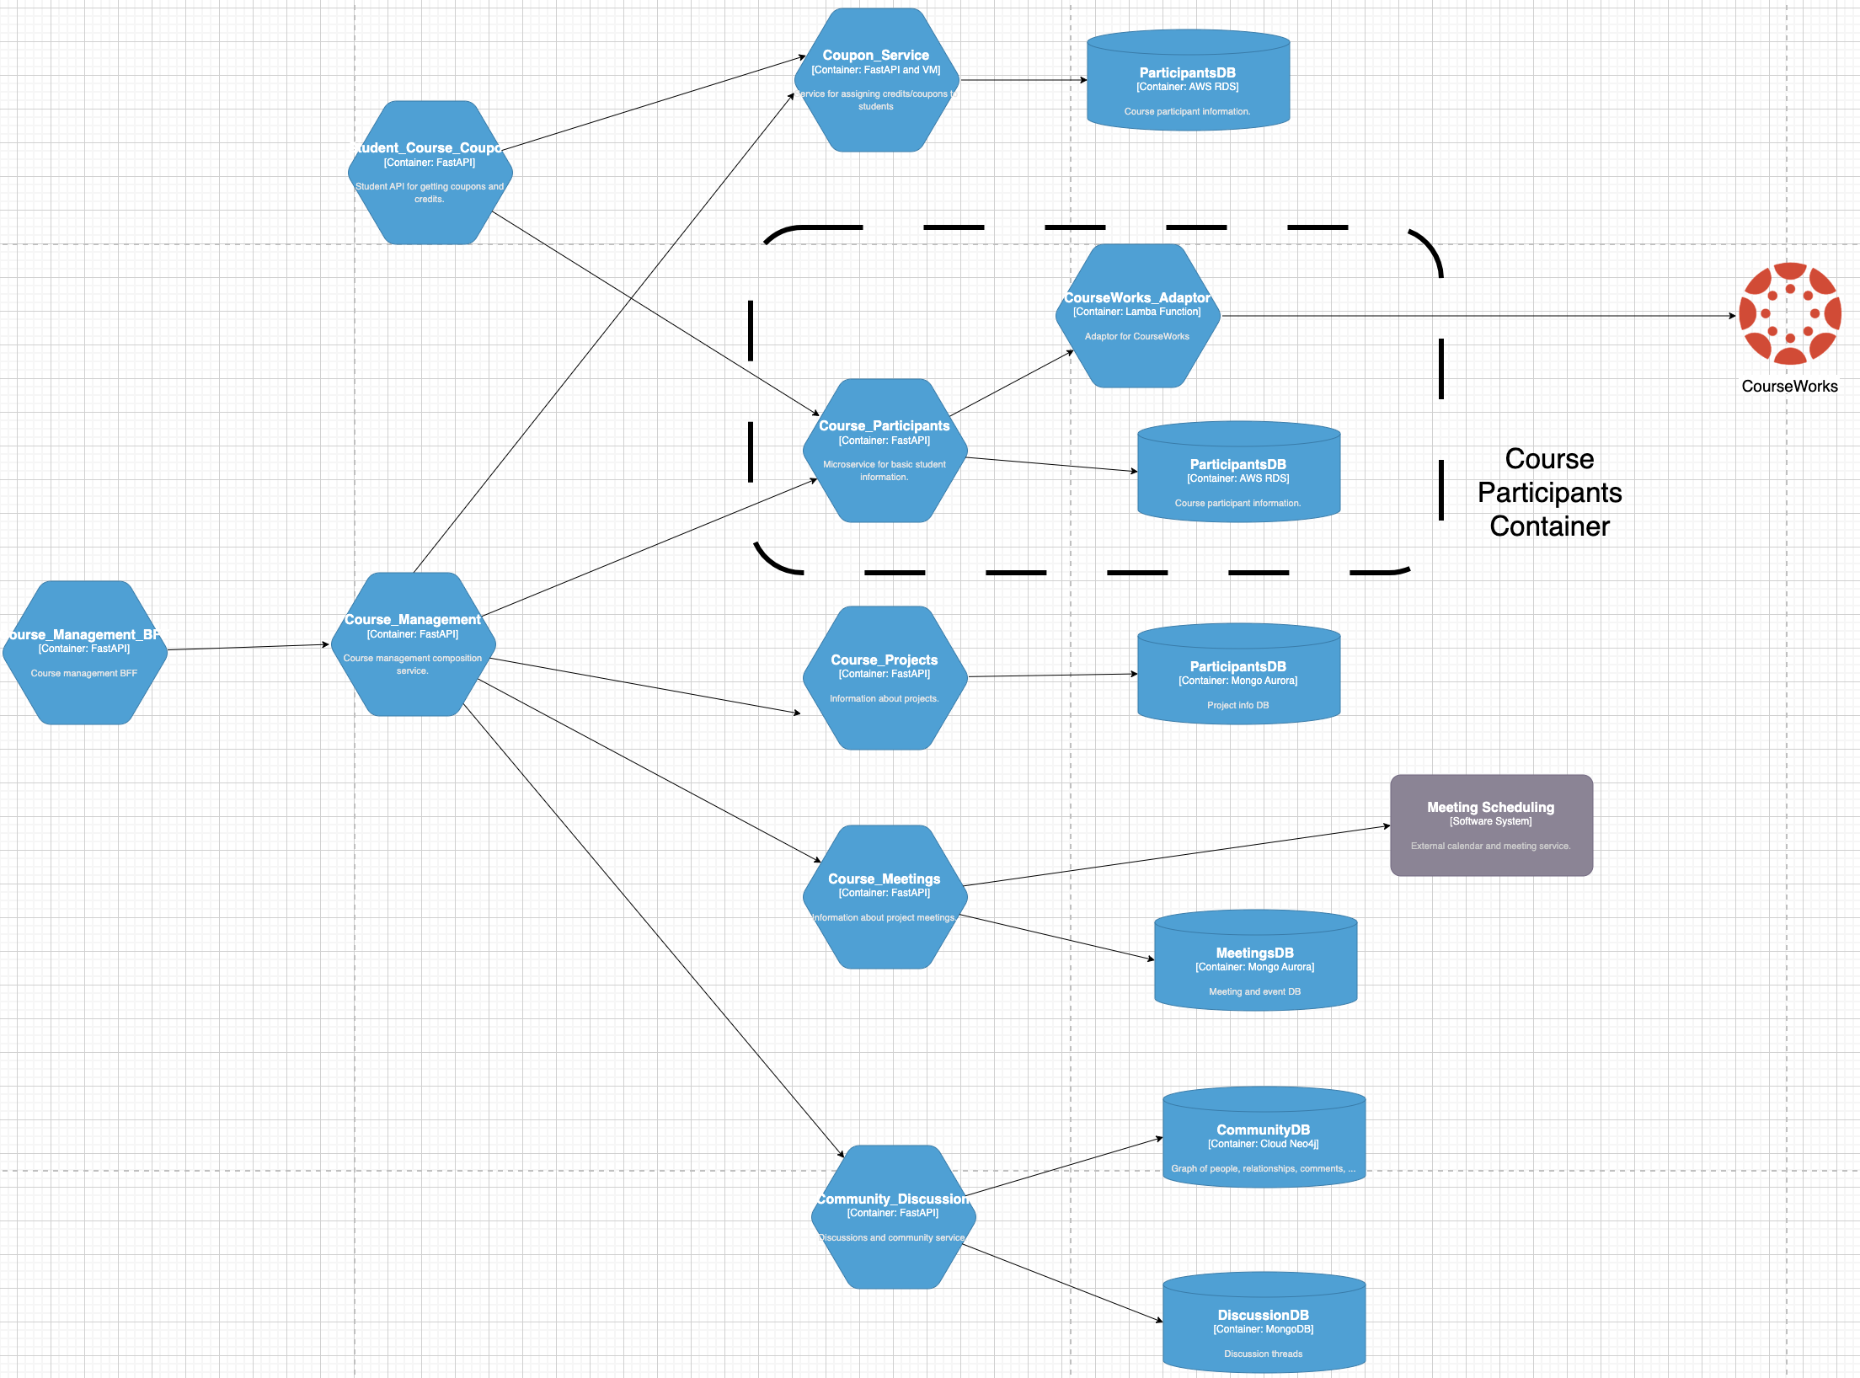
(Partial) Logical View – Interactive System

Slide 34
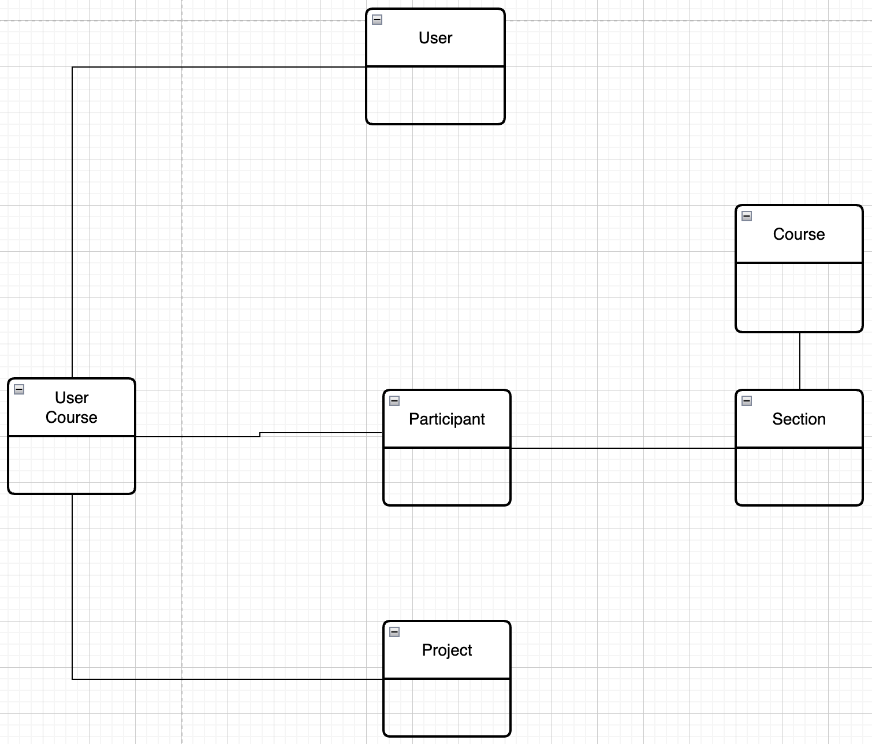
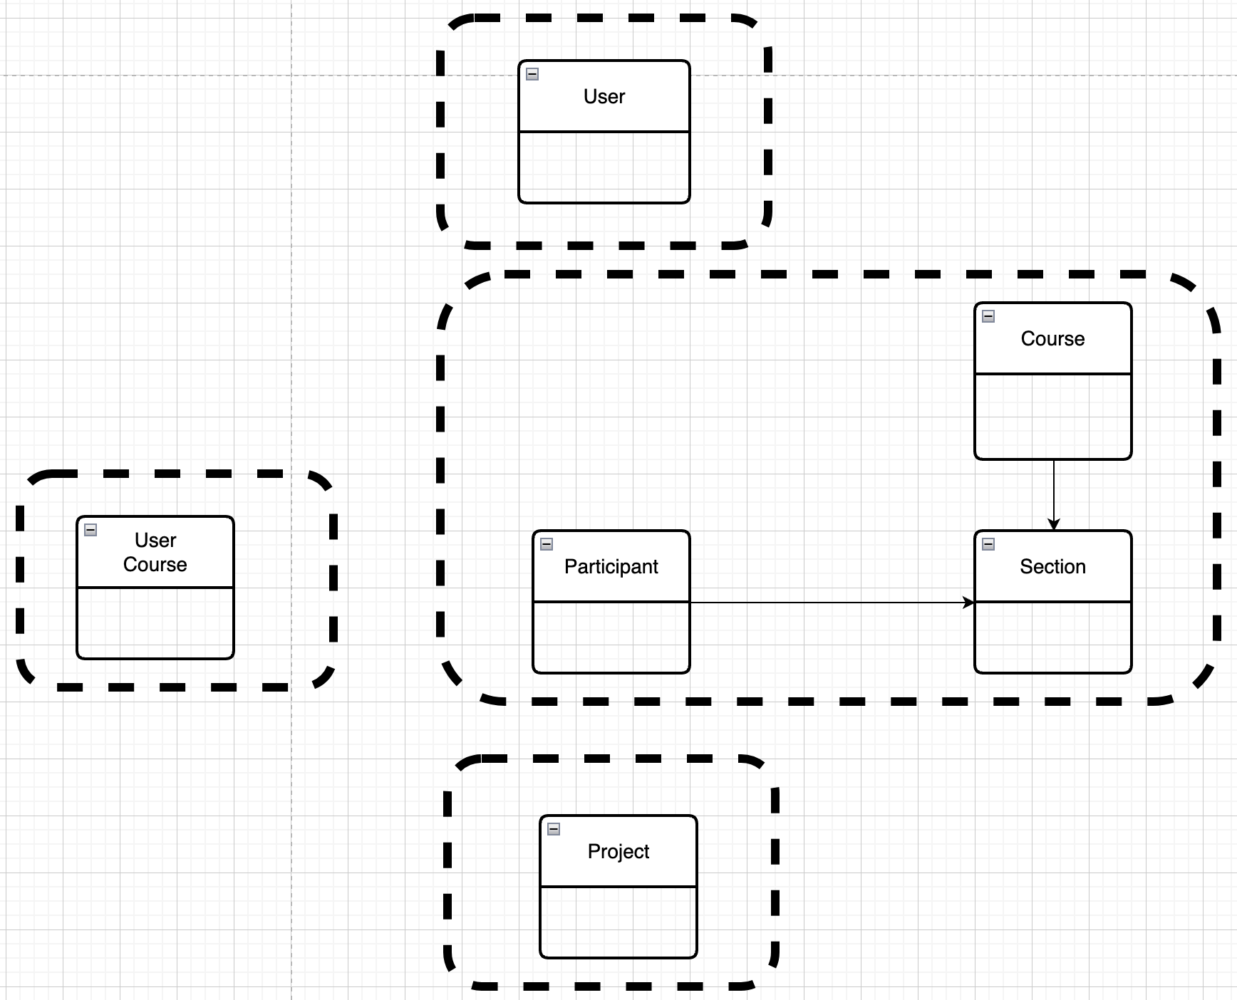
Resource Oriented and Microservices – My Project
Mapped to Microservices
Conceptual Model -- User, Project, Course
This creates some interesting challenges, e.g.
Joins
Foreign Keys
If the cluster of resources might be useful in other solutions → It may be a microservice.

Slide 35
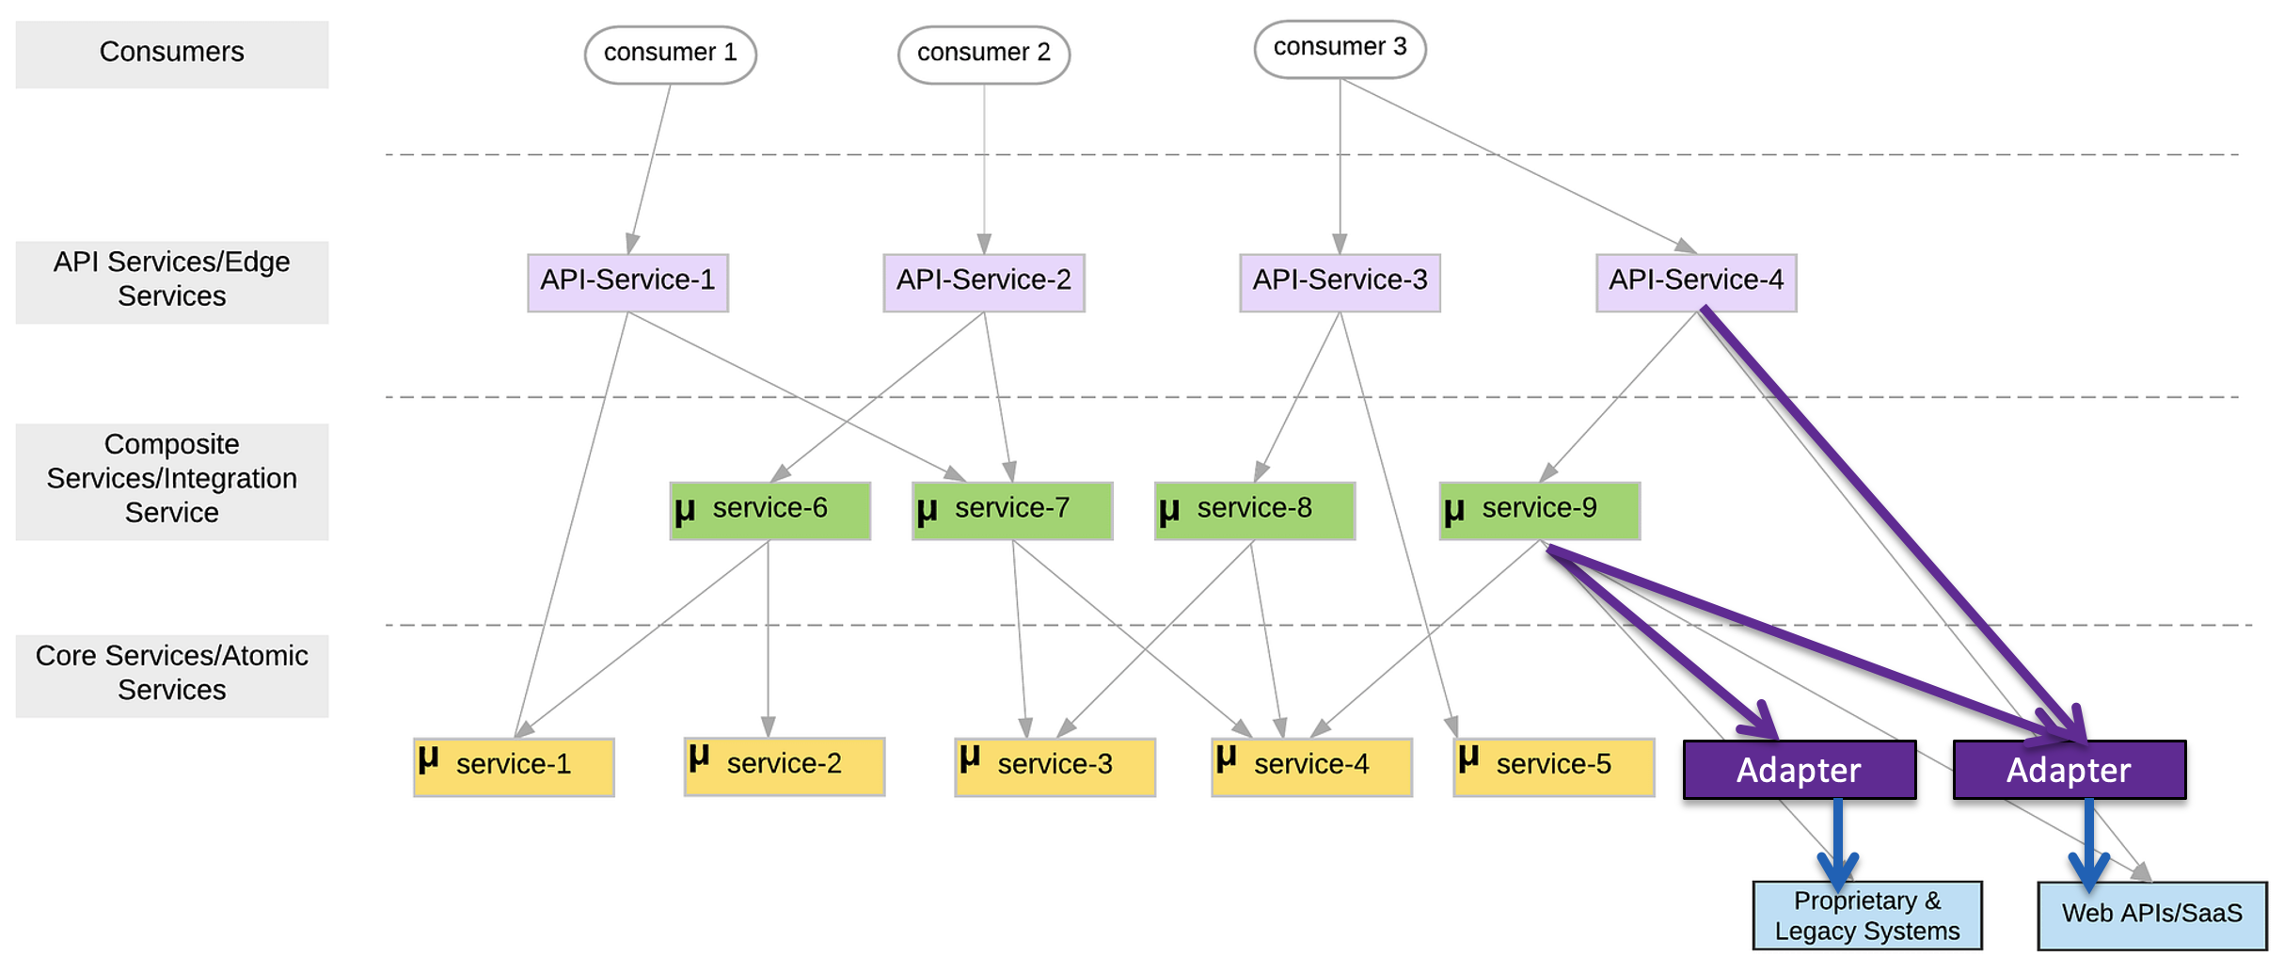
Atomic and Composition

Slide 36
First Group of Microservices
My first sprint with have 5 microservices:
5 core/atomic microservices:
user_info
courseworks_adaptor
course_info
student_coupons
project_teams
1 composite/integration microservice: core_course_management
The composite service:
Implements “consistency” in the data in the core services, e.g. “foreign keys.”
Eliminates the need for complex logic in the UI or client, which would be impacted by changes.
Exposes only information from the basic services that the client requires.
The composite service is conceptually similar to a database view.

Slide 37
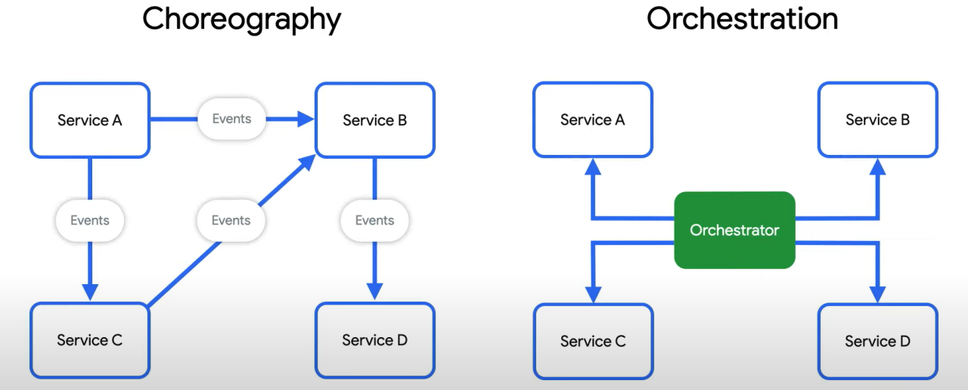
Behavioral Composition
There are two base patterns: choreography and orchestration.
There also several different implementation technologies and choices.
And many related concepts, e.g. Sagas, Event Driven Architectures, Pub/Sub, … …
We will cover and explore incrementally, but for now we will keep it simple and do traditional “if … then …” code.

Slide 38
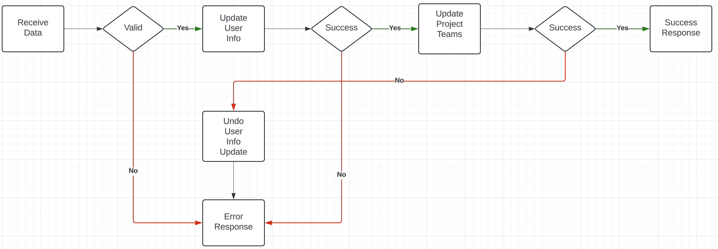
Composite Microservice Logic
The GET on the composite invokes GET on several atomic services. This can occur synchronously or asynchronously in parallel.
PUT, POST and DELETE are more complex. Your logic may have to undo some delegated updates that occur if others fail.
To get started, we will just use simple logic but explore more complex approaches.

Slide 39
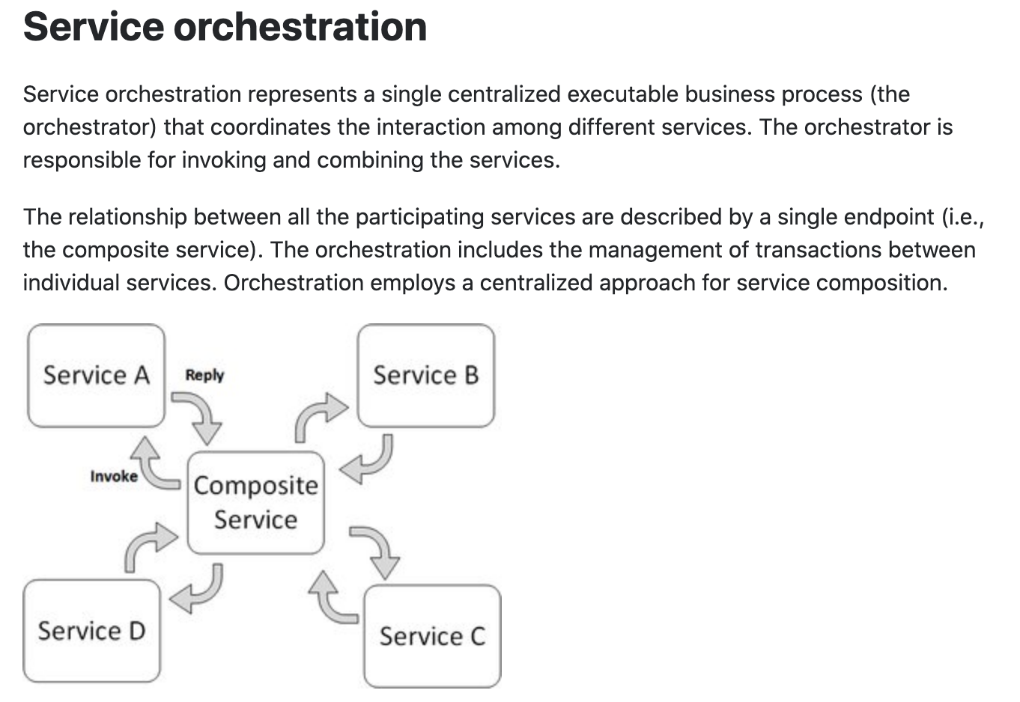
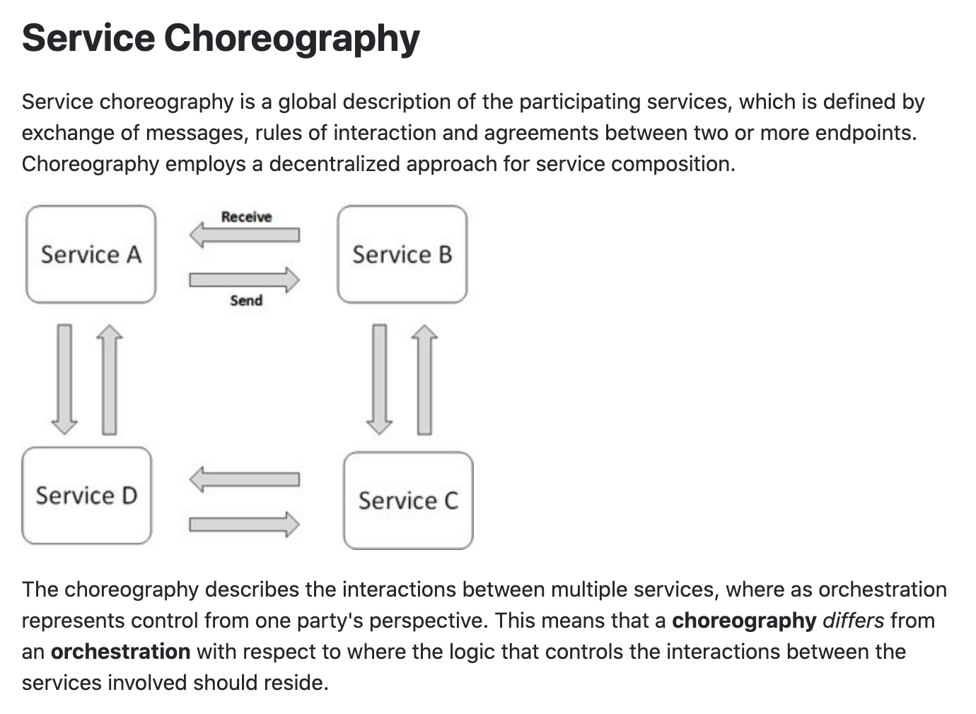
Concepts
These are not formally, rigorously defined terms.

Slide 40
In Code: Composition and Asynchronous Method Invocation
Composite operations can “take a while.”
“Holding open connections and waiting can be bad.”
Consumes resources.
Connections can break.
... ...
There are two options:
Polling
Callbacks
Our next pattern is composition and “polling.” Create a new user requires:
Updating the user database.
Verifying a submitted address.
Creating an account in the catalog service.
Request
202 ACCEPTED Location
GET (Poll)
200

Slide 41
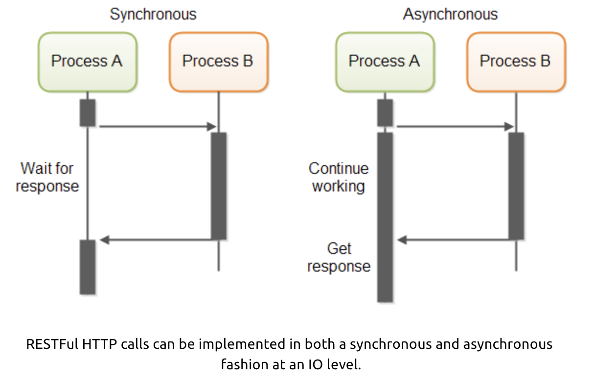
In Code: Service Orchestration/Composition
One call to a composite service
May drive calls to multiple other services.
Which in turn, may drive multiple calls to other services.
Synchronous (Wait) and calling one at a time, in order is
Inefficient
Fragile
... ...
Asynchronous has benefits but can result in complex code.

Slide 42
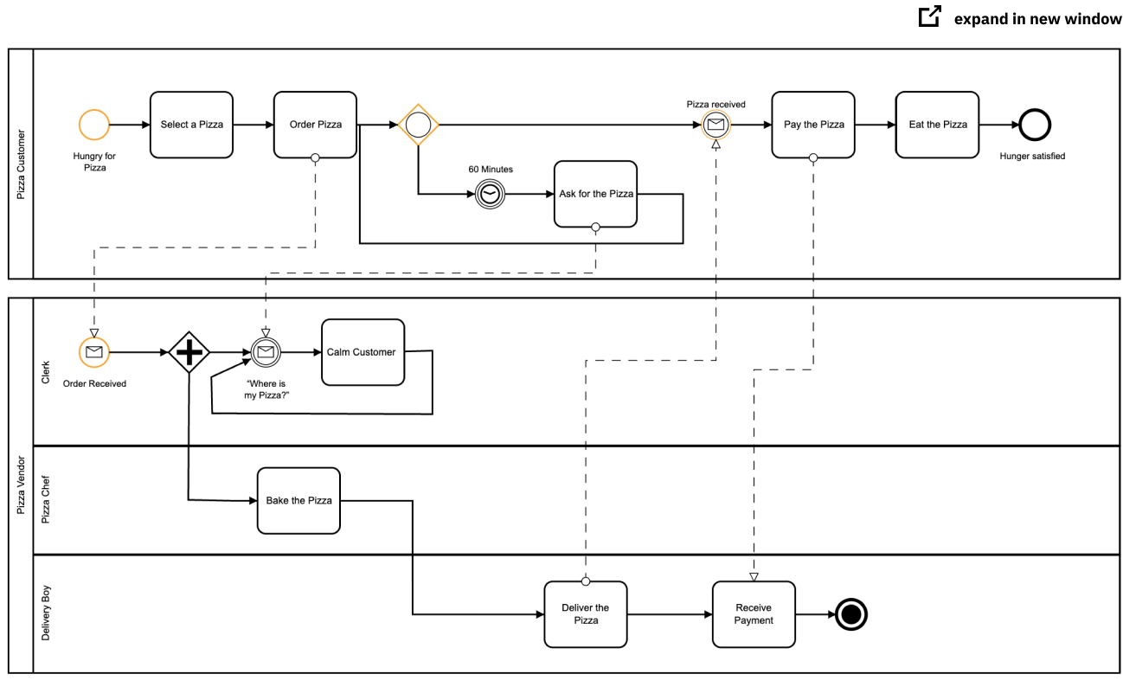
Service Orchestration
Implementing a complex orchestration in code can become complex.
High layer abstractions and tools have emerged, e.g. BPMN.
“Business Process Model and Notation (BPMN) is a graphical representation for specifying business processes in a business process model.”
There are products for defining BPMN processes, generating code, executing, … …, e.g. Camunda: https://camunda.com/bpmn/
There are other languages, tools, execution engines, … …

Slide 43
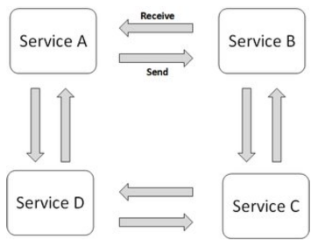
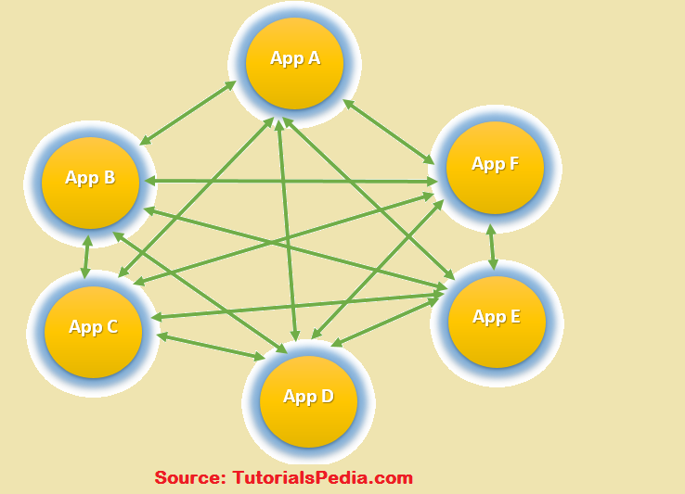
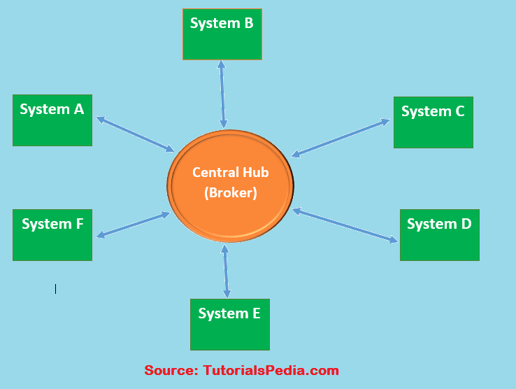
Choreography
We saw the basic diagram, but … this is an anti-pattern and does not scale.
But, how do you write the event driven microservices?
Well, you can just write code … …
Or use a state machines abstraction.
… …

Slide 44
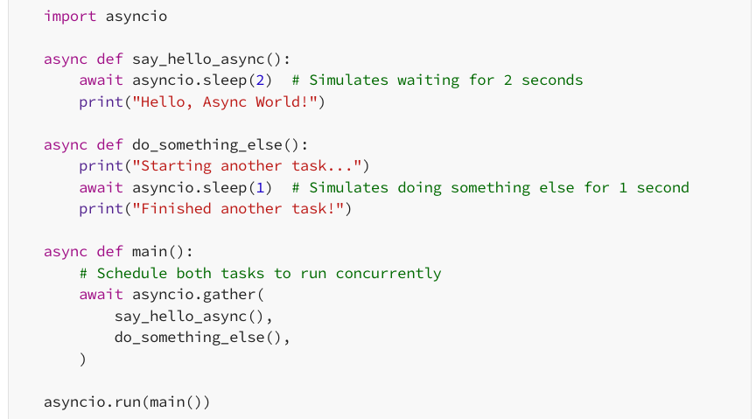
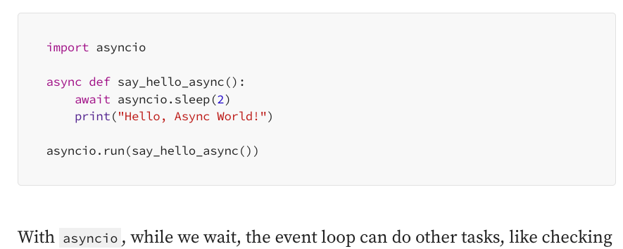
Next Steps
We will start implementing a composition microservice for your project.
The initial implementation will use orchestration.
Synchronously calling the orchestrated microservices using “standard code.”
Asynchronously calling the orchestrated code using threads, promises, …
We will then look at other models, e.g. EDA, MDP, State Machines, … …
https://medium.com/@moraneus/mastering-pythons-asyncio-a-practical-guide-0a673265cf04

Slide 45
Next Steps
See for more complete example: https://github.com/donald-f-ferguson/W4153-Cloud-Computing-Base/blob/3d94111a1018b8b5aba9069a333f1e030d75d503/simple_examples/sync_async
https://app.swaggerhub.com/search?owner=Columbia-Classes&visibility=PUBLIC

Slide 46
Middleware
46 | W4153-F24-6-REST(4)-OAuth2-Middleware-Composition © Donald F. Ferguson, 2024

Slide 47
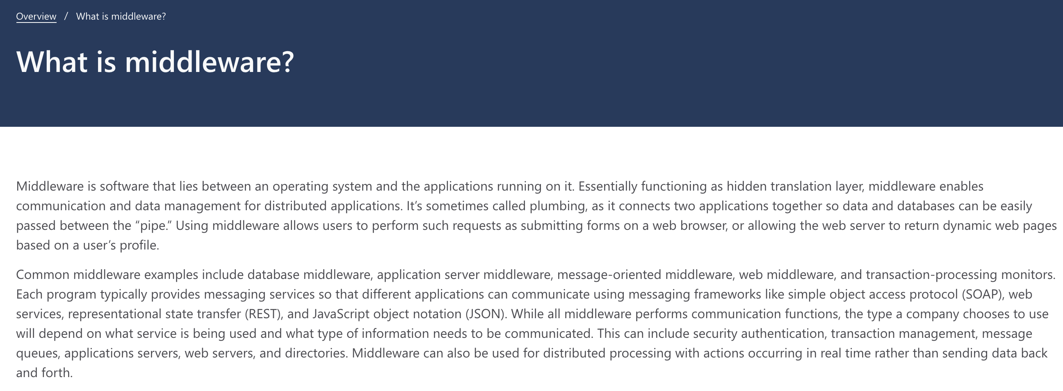
Middleware

Slide 48
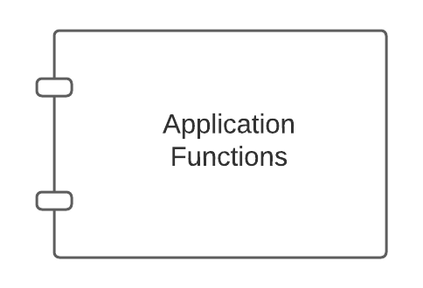
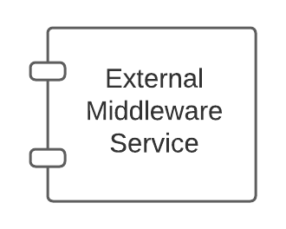
Middleware – Conceptual Model
Middleware:
Application might call directly, e.g. DB
May be implicitly called as part of request processing, e.g. logging.

Slide 49
Middleware – Conceptual Model
This is another example of
Single Responsibility
Separation of Concerns
Being a good application logic developer and a good middleware developer are different roles, skill sets, … …
Also an example of the
Closed for modification, but
Open for extension
Middleware:
Application might call directly, e.g. DB
May be implicitly called as part of request processing, e.g. logging.

Slide 50
FastAPI Middleware (https://medium.com/@saverio3107/mastering-middleware-in-fastapi-from-basic-implementation-to-route-based-strategies-d62eff6b5463)
What Does Middleware Do?
Incoming Request: When a request comes in, the middleware can examine and even modify parts of the request like cookies, headers, query parameters, etc., before it reaches the actual API service method. For example, it can validate the request, authenticate the user, or log the request details.
Outgoing Response: After the API service method has processed the request and generated a response, the middleware gets a chance to inspect and modify the response before it goes back to the client. This can include things like changing the response headers, transforming the content, and so on.

Slide 51
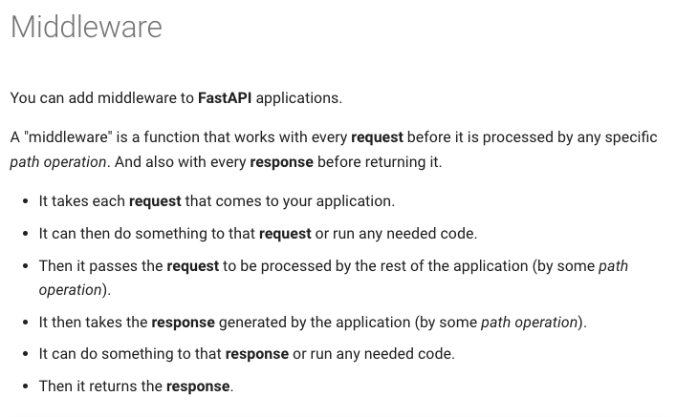
FastAPI Middleware
https://fastapi.tiangolo.com/tutorial/middleware/
https://fastapi.tiangolo.com/advanced/middleware/

Slide 52
Example
Walk through Medium Article
https://medium.com/@saverio3107/mastering-middleware-in-fastapi-from-basic-implementation-to-route-based-strategies-d62eff6b5463
This is the very simple version. There is a more sophisticated approach to middleware in FastAPI. https://fastapi.tiangolo.com/advanced/middleware/

Slide 53
12 Factor Apps
SOLID Design Patterns
53 | W4153-F24-6-REST(4)-OAuth2-Middleware-Composition © Donald F. Ferguson, 2024

Slide 54
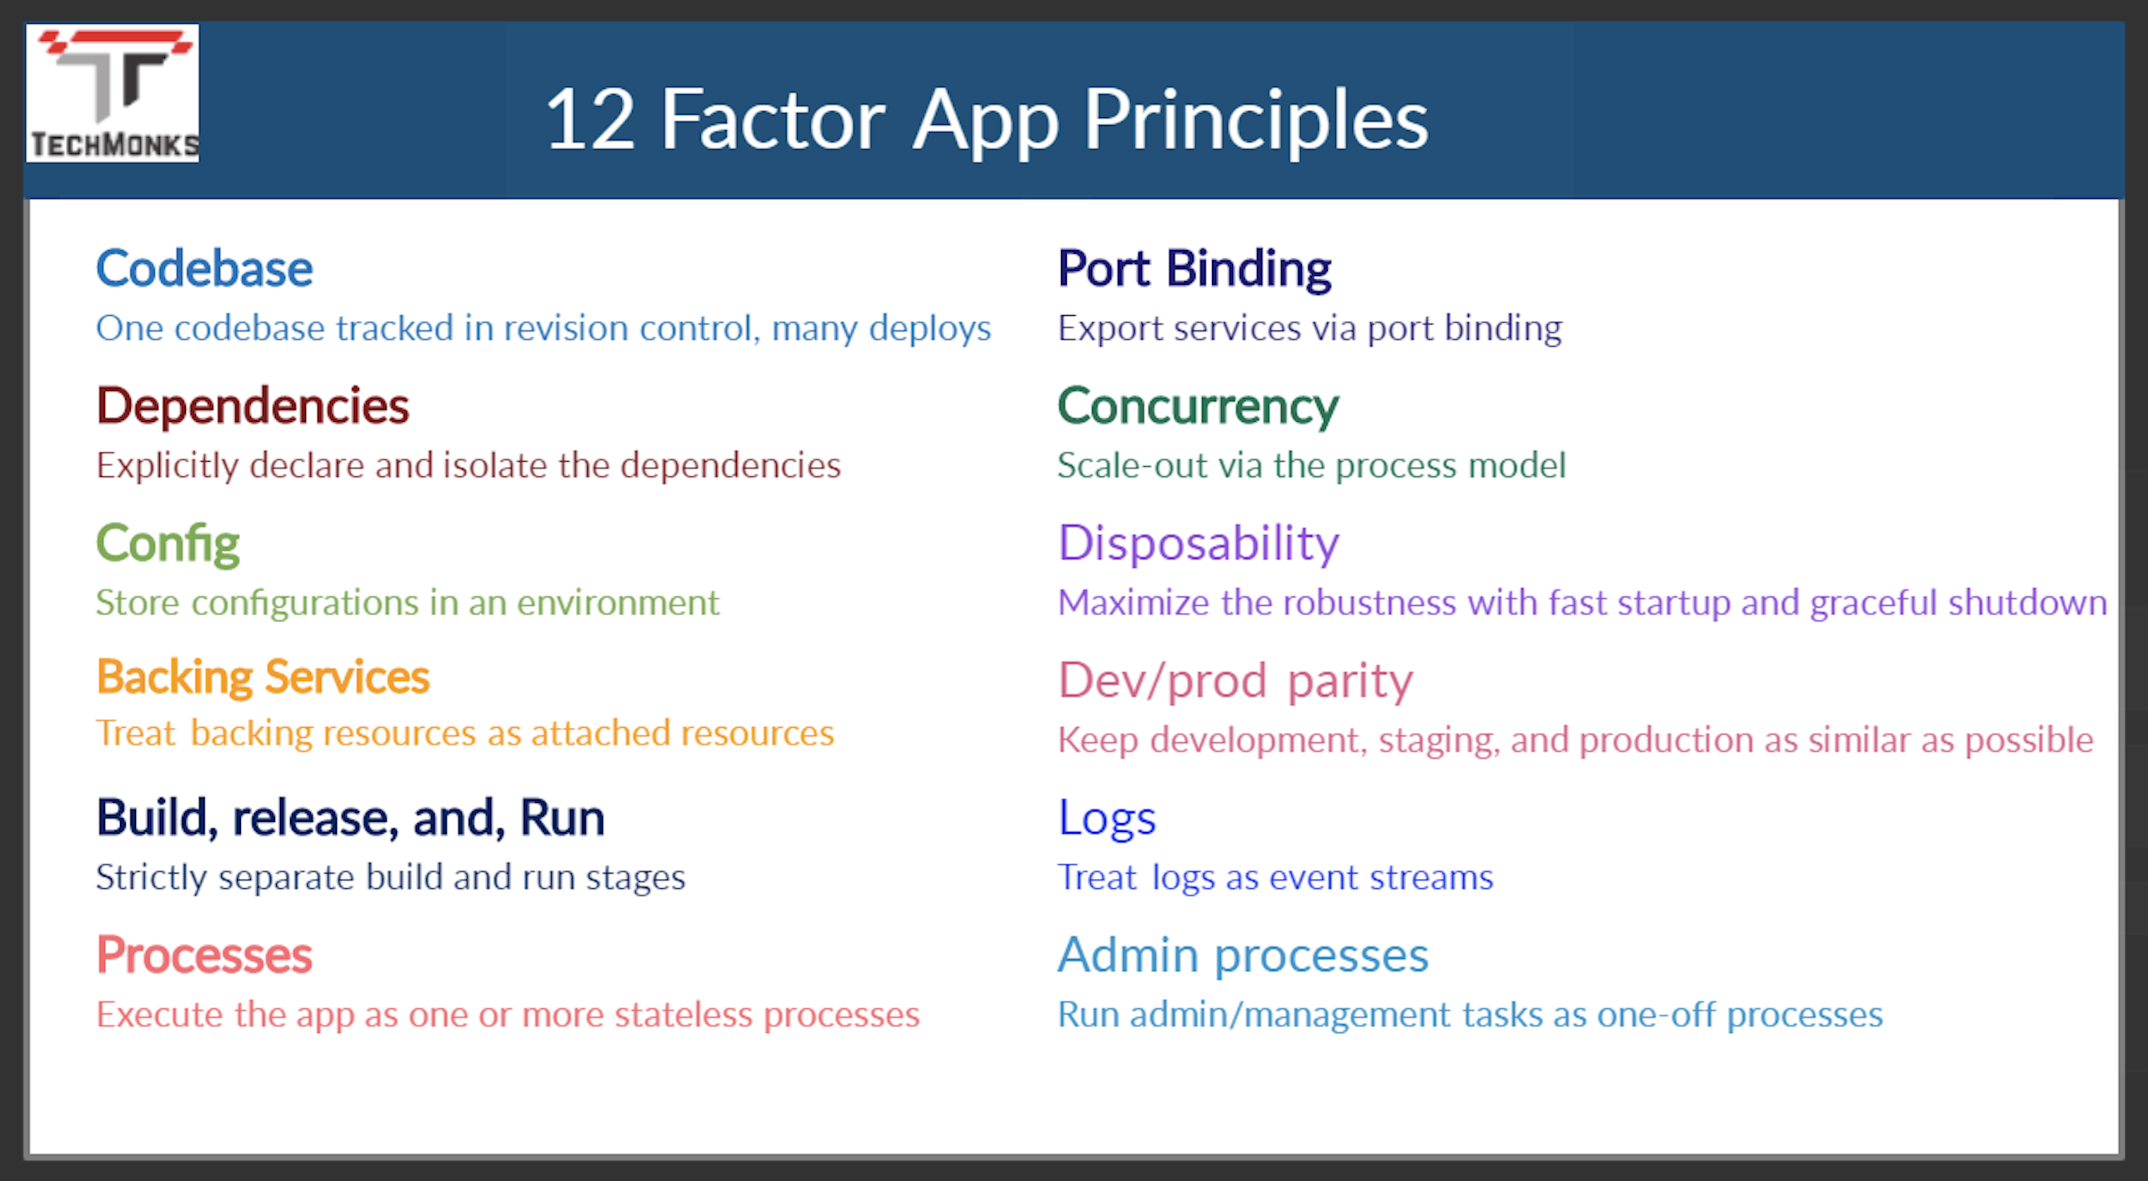
12 Factor Applications
https://dzone.com/articles/12-factor-app-principles-and-cloud-native-microser

Slide 55
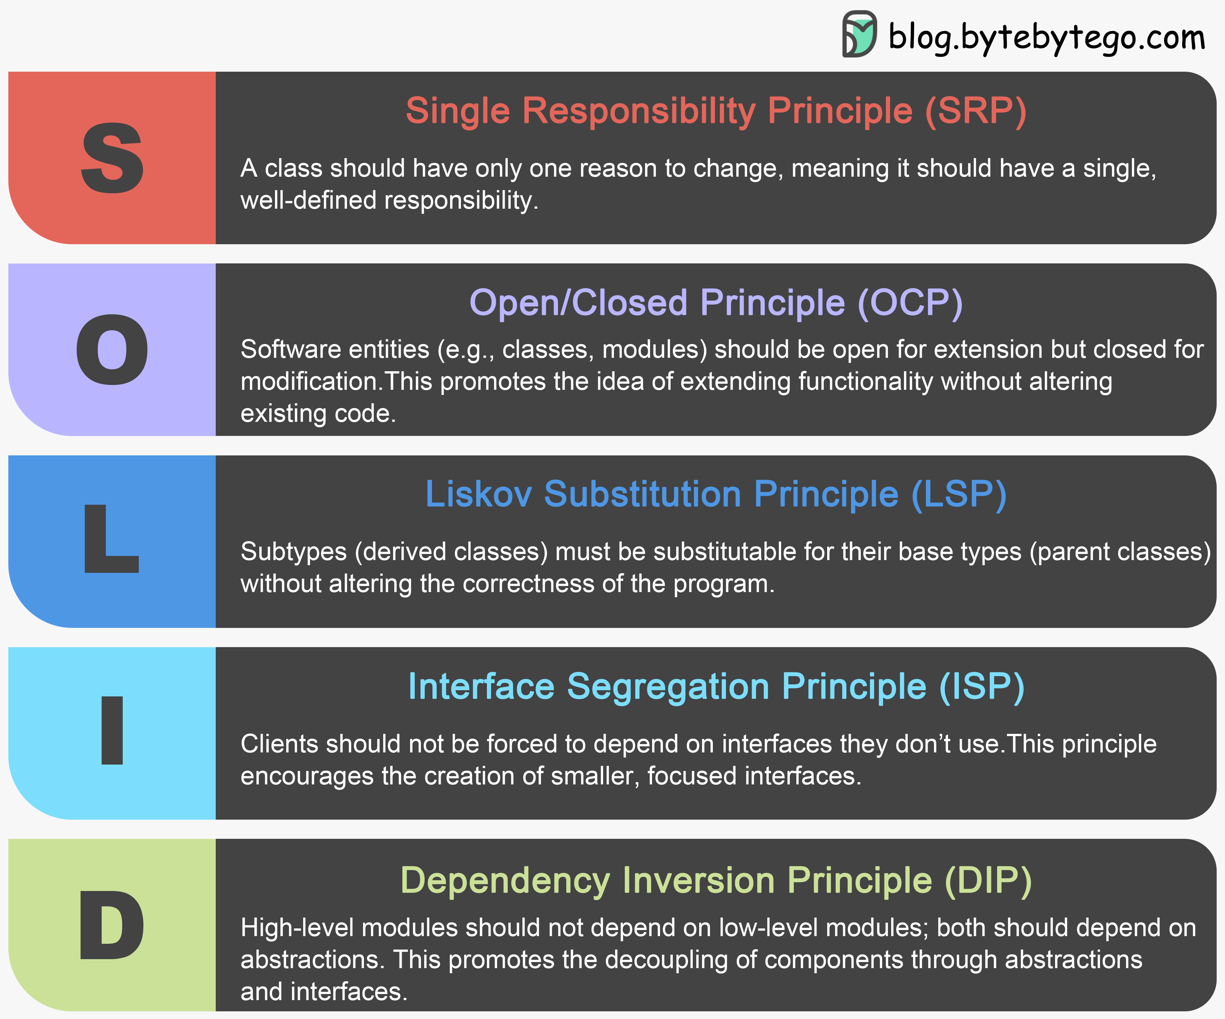
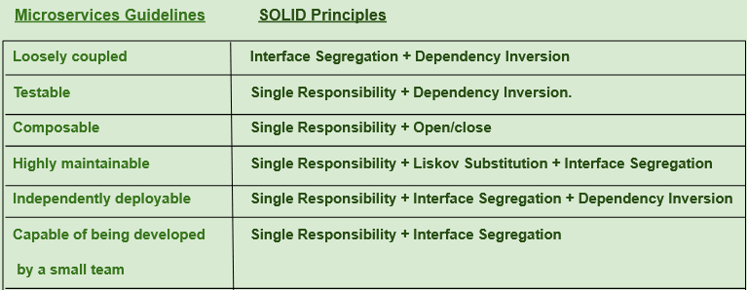
SOLID Principles
https://medium.com/@saurabh.engg.it/microservices-designing-effective-microservices-by-following-solid-design-principles-a995c3a033a0
This is a good overview article, and we will see patterns in later lectures.
This slide and the preceding slides could have been a 60 slide presentation.
If you put 3 SW architects into a room, you will get 15 design principles and patterns.
Use common sense.

Slide 56
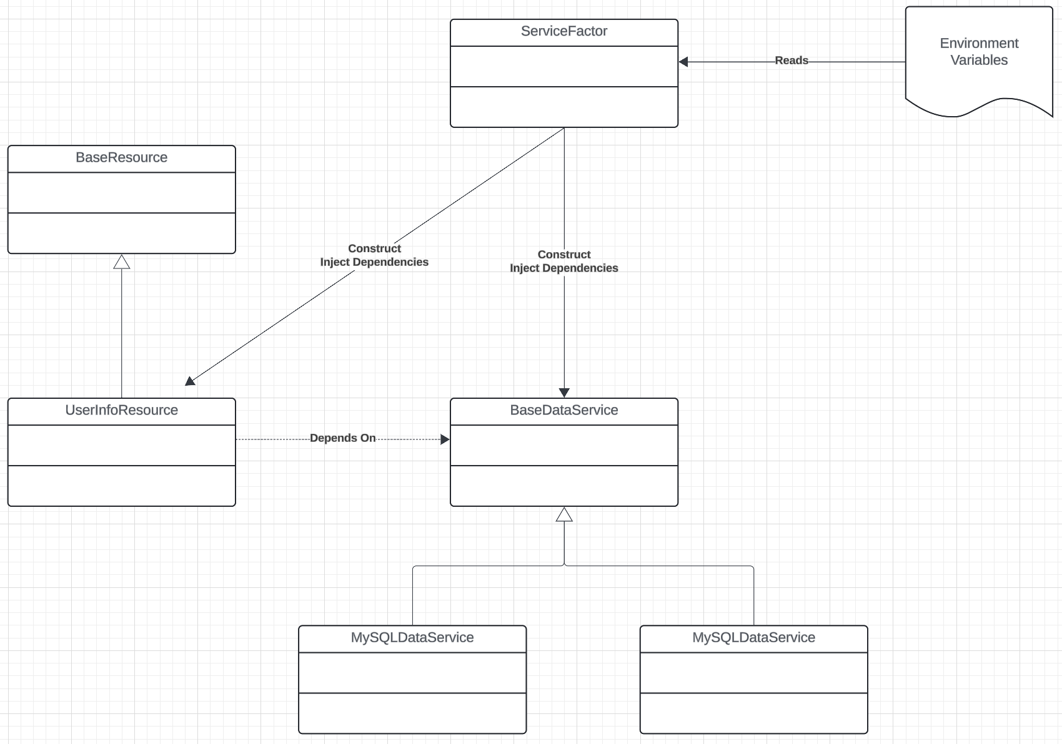
SW Architecture
Use interfaces, or the language equivalent/approximation.
A constructor receive a “config” object that is a dictionary of
Interface name.
Reference to implementation.
Parameters and configuration properties are also in the config, e.g.
URLs
“Passwords”
Database and table names
… …
A “service factory” creates the specific instances and configs, and wires it all together.

Slide 57
12 Factor Applications
https://dzone.com/articles/12-factor-app-principles-and-cloud-native-microser

Slide 58
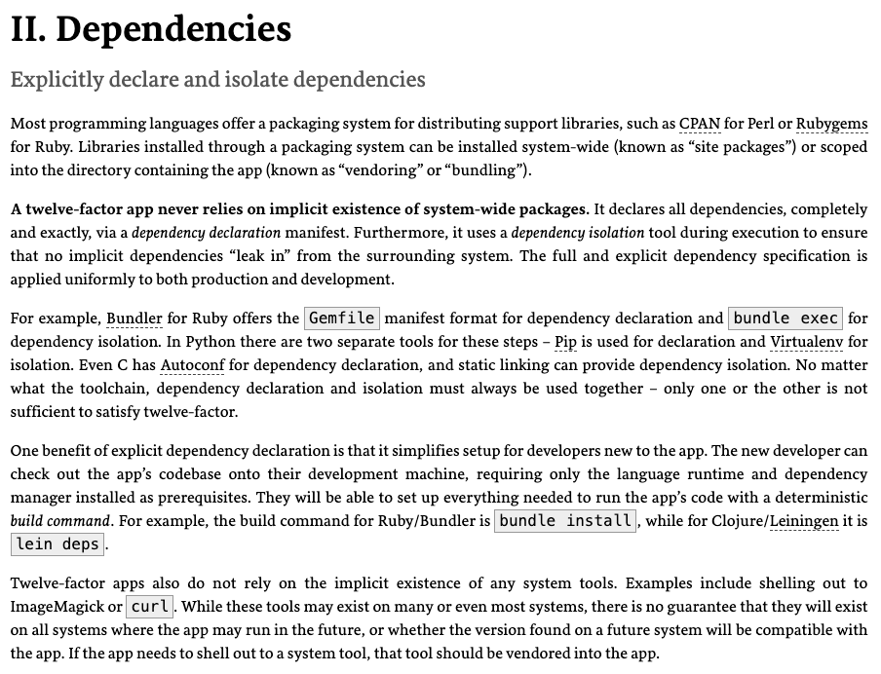
Dependencies
Most application frameworks have a dependency declaration concept.
I have been showing examples with:
Python import
requirements.txt
etc.
My examples also show encapsulating libraries and APIs with Python classes.
II. Dependencies handles “the code,” but we still need to handle the instance. There is a difference between, e.g.
pymysql
A specific connection.

Slide 59
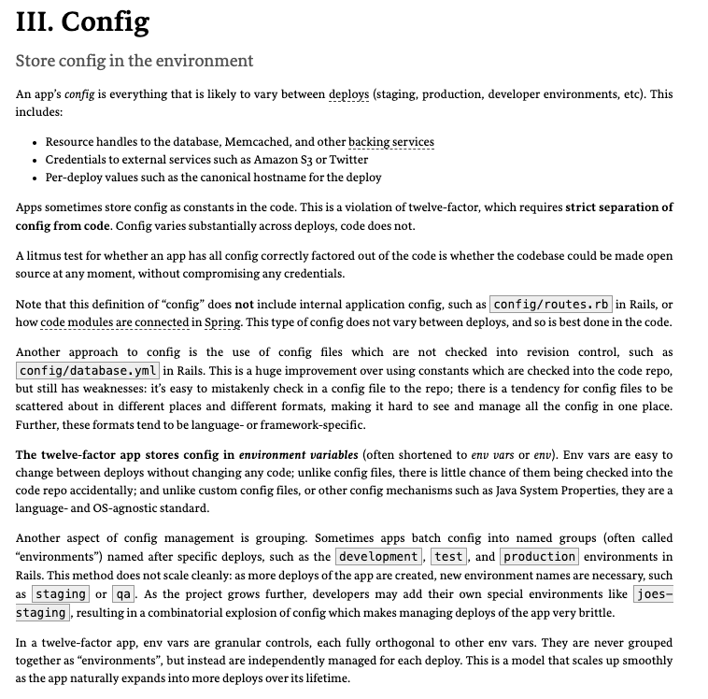
III. Configurations
Each of the deployment environments we have seen has a method for setting environment variables.
https://docs.aws.amazon.com/cloud9/latest/user-guide/env-vars.html
https://docs.aws.amazon.com/elasticbeanstalk/latest/dg/environments-cfg-softwaresettings.html
https://cloud.google.com/functions/docs/configuring/env-var
CI/CD, GitHub actions, etc. can integrate environment variables with the development process.
Vaults and secrets managers are a better approach for passwords.

Slide 60


IV. Backing Services
My code has shown encapsulating backing services with a shallow adaptor.
This is an example of the adaptor pattern.
You seen examples of things like AbstractBaseDataService, … …
The approach is also an application of several aspects of SOLID. (https://en.wikipedia.org/wiki/SOLID)

Slide 61
Structural Composition
We can use four patterns/principles for service composition ”in code.”
Dependency Injection
Service Factory
Service Locator
Metadata in the environment for configuration.
I did some simple examples in https://github.com/donald-f-ferguson/E6156-Public-Examples/tree/master/old_examples/simple_pattern_examples.
Or actually, I asked ChatGPT to produce simple examples.
And, these are conceptual, and I am not super happy with them.

Slide 62


Dependency Injection
Concepts (https://en.wikipedia.org/wiki/Dependency_injection):
In software engineering, dependency injection is a technique in which an object receives other objects that it depends on, called dependencies.
The intent behind dependency injection is to achieve separation of concerns of construction and use of objects. This can increase readability and code reuse.
There is no single approach. There are several frameworks, tools, etc.
Like many other things, it is easy to get carried away and become dogmatic.
I follow a single approach:
A Context class converts environment and other configuration and provides to application.
The top-level application injects a config_info object into services.

Slide 63

Service Factory
“In class-based programming, the factory method pattern is a creational pattern that uses factory methods to deal with the problem of creating objects without having to specify the exact class of the object that will be created. This is done by creating objects by calling a factory method—either specified in an interface and implemented by child classes, or implemented in a base class and optionally overridden by derived classes—rather than by calling a constructor.” (https://en.wikipedia.org/wiki/Factory_method_pattern)
You will sometimes see me use this for
Abstraction between a REST resource impl. and the data service.
Allows changing the database service, model, etc. without modifying the code.
Concrete implementation choices are configured via properties, metadata, …
You can use in many situations.
https://www.tutorialspoint.com/design_pattern/factory_pattern.htm

Slide 64


Service Locator
“The service locator pattern is a design pattern used in software development to encapsulate the processes involved in obtaining a service with a strong abstraction layer. This pattern uses a central registry known as the "service locator", which on request returns the information necessary to perform a certain task. Proponents of the pattern say the approach simplifies component-based applications where all dependencies are cleanly listed at the beginning of the whole application design, …” (https://en.wikipedia.org/wiki/Service_locator_pattern)
Configuration Information

Slide 65
Interesting References
65 | W4153-F24-6-REST(4)-OAuth2-Middleware-Composition © Donald F. Ferguson, 2024

Slide 66
Interesting Articles
https://medium.com/@cihanelibol99/authorization-architecture-in-microservices-68085d31f1e1
https://medium.com/@sylvain.tiset/top-10-microservices-design-patterns-you-should-know-1bac6a7d6218

Slide 67
Where Are We Going With All Of This?
67 | W4153-F24-6-REST(4)-OAuth2-Middleware-Composition © Donald F. Ferguson, 2024

